Slide 1
Forest Park Southeast, Botanical Heights, Central West End, Medical Campus
Monthly Crime report: November 2019 Washington University Medical Center

Slide 2
Forest Park Southeast: Summary Notes
24 total crimes in November 2019
85% change compared to November 2018 (13 total crimes)
1 crime(s) against persons in November 2019
0% change compared to November 2018 (1 crimes against persons)
286 total crimes in 2019
794% change compared to this time in 2018 (32 total crimes)
40 crime(s) against persons in 2019
300% change compared to this time in 2018 (10 crimes against persons)

Slide 3
Forest Park Southeast: Year to Year Comparison
Part 1 Crimes | Jan | Feb | Mar | Apr | May | Jun | Jul | Aug | Sep | Oct | Nov | Dec | Total
0 | 0 | 0 | 0 | 0 | 0 | 0 | 0 | 0 | 0 | 0 | 0 | 0 | 0
Aggravated Assault | 0 | 0 | 0 | 0 | 0 | 0 | 0 | 0 | 0 | 7 | 0 | 3 | 10
Arson | 0 | 0 | 0 | 0 | 0 | 0 | 0 | 0 | 0 | 0 | 0 | 0 | 0
Burgalry | 0 | 0 | 0 | 0 | 0 | 0 | 0 | 0 | 0 | 1 | 0 | 0 | 1
Homicide | 0 | 0 | 0 | 0 | 0 | 0 | 0 | 0 | 0 | 0 | 0 | 0 | 0
Larceny | 0 | 0 | 0 | 0 | 0 | 0 | 0 | 0 | 0 | 7 | 10 | 3 | 20
Motor Vehicle Theft | 0 | 0 | 0 | 0 | 0 | 0 | 0 | 0 | 0 | 2 | 2 | 2 | 6
Robbery | 0 | 0 | 0 | 0 | 0 | 0 | 0 | 0 | 0 | 2 | 1 | 2 | 5
Total | 0 | 0 | 0 | 0 | 0 | 0 | 0 | 0 | 0 | 19 | 13 | 10 | 42
Part 1 Crimes | Jan | Feb | Mar | Apr | May | Jun | Jul | Aug | Sep | Oct | Nov | Total
Aggravated Assault | 0 | 3 | 1 | 2 | 2 | 4 | 2 | 0 | 2 | 5 | 0 | 21
Arson | 0 | 0 | 1 | 0 | 0 | 1 | 0 | 0 | 0 | 0 | 0 | 2
Burgalry | 0 | 0 | 1 | 1 | 0 | 0 | 3 | 1 | 4 | 8 | 3 | 21
Homicide | 0 | 0 | 0 | 0 | 0 | 0 | 0 | 0 | 1 | 0 | 0 | 1
Larceny | 7 | 10 | 15 | 12 | 9 | 21 | 17 | 18 | 24 | 35 | 17 | 185
Motor Vehicle Theft | 3 | 6 | 1 | 2 | 0 | 4 | 6 | 1 | 8 | 3 | 3 | 37
Robbery | 1 | 0 | 1 | 1 | 2 | 5 | 2 | 1 | 2 | 3 | 1 | 19
Total | 11 | 19 | 20 | 18 | 13 | 35 | 30 | 21 | 41 | 54 | 24 | 286

Slide 4
Forest Park Southeast: Summary Tables
Part 1 Crimes | Number of Crimes
Burgalry | 3
Larceny | 17
Motor Vehicle Theft | 3
Robbery | 1
Total | 24
Day of the Week | Number of Crimes
Sun | 5
Mon | 5
Tue | 2
Wed | 4
Thu | 2
Fri | 2
Sat | 4
Total | 24
Crimes Against Persons | Number of Crimes
FALSE | 23
TRUE | 1
Total | 24
Time of Day | Number of Crimes
Day | 20
Night | 4
Total | 24

Slide 5
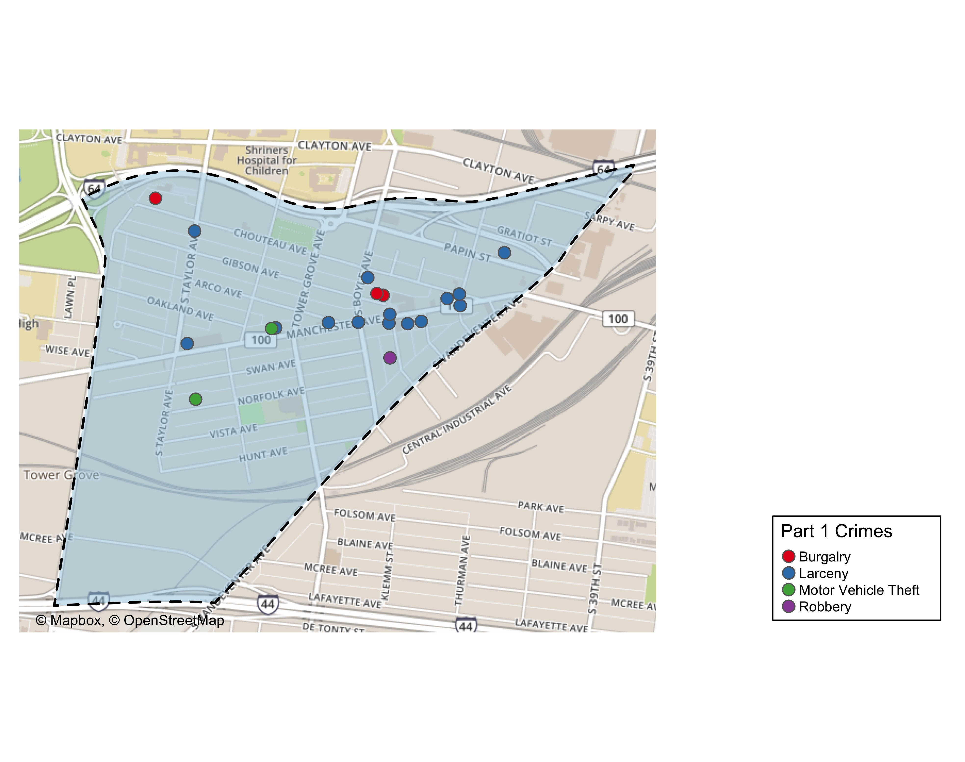
Forest Park Southeast: Total Crime Map

Slide 6
Botanical Heights: Summary Notes
7 total crimes in November 2019
-22% change compared to November 2018 (9 total crimes)
1 crime(s) against persons in November 2019
0% change compared to November 2018 (1 crimes against persons)
76 total crimes in 2019
347% change compared to this time in 2018 (17 total crimes)
14 crime(s) against persons in 2019
1 300% change compared to this time in 2018 (1 crimes against persons)

Slide 7
Botanical Heights: Year to Year Comparison
Part 1 Crimes | Jan | Feb | Mar | Apr | May | Jun | Jul | Aug | Sep | Oct | Nov | Dec | Total
0 | 0 | 0 | 0 | 0 | 0 | 0 | 0 | 0 | 0 | 0 | 0 | 0 | 0
Aggravated Assault | 0 | 0 | 0 | 0 | 0 | 0 | 0 | 0 | 0 | 0 | 1 | 1 | 2
Arson | 0 | 0 | 0 | 0 | 0 | 0 | 0 | 0 | 0 | 0 | 0 | 0 | 0
Burgalry | 0 | 0 | 0 | 0 | 0 | 0 | 0 | 0 | 0 | 4 | 2 | 5 | 11
Homicide | 0 | 0 | 0 | 0 | 0 | 0 | 0 | 0 | 0 | 0 | 0 | 0 | 0
Larceny | 0 | 0 | 0 | 0 | 0 | 0 | 0 | 0 | 0 | 4 | 4 | 2 | 10
Motor Vehicle Theft | 0 | 0 | 0 | 0 | 0 | 0 | 0 | 0 | 0 | 0 | 2 | 0 | 2
Robbery | 0 | 0 | 0 | 0 | 0 | 0 | 0 | 0 | 0 | 0 | 0 | 0 | 0
Total | 0 | 0 | 0 | 0 | 0 | 0 | 0 | 0 | 0 | 8 | 9 | 8 | 25
Part 1 Crimes | Jan | Feb | Mar | Apr | May | Jun | Jul | Aug | Sep | Oct | Nov | Total
Aggravated Assault | 0 | 0 | 0 | 0 | 4 | 0 | 0 | 1 | 0 | 0 | 2 | 7
Arson | 0 | 0 | 0 | 0 | 0 | 0 | 0 | 0 | 0 | 0 | 0 | 0
Burgalry | 2 | 0 | 0 | 2 | 0 | 0 | 1 | 1 | 3 | 0 | 1 | 10
Homicide | 0 | 0 | 0 | 0 | 0 | 0 | 0 | 0 | 0 | 0 | 0 | 0
Larceny | 2 | 3 | 6 | 3 | 3 | 3 | 9 | 1 | 5 | 4 | 3 | 42
Motor Vehicle Theft | 1 | 1 | 3 | 0 | 1 | 1 | 0 | 1 | 0 | 1 | 1 | 10
Robbery | 0 | 2 | 0 | 0 | 1 | 1 | 0 | 0 | 0 | 3 | 0 | 7
Total | 5 | 6 | 9 | 5 | 9 | 5 | 10 | 4 | 8 | 8 | 7 | 76

Slide 8
Botanical Heights: Summary Tables
Part 1 Crimes | Number of Crimes
Aggravated Assault | 2
Burgalry | 1
Larceny | 3
Motor Vehicle Theft | 1
Total | 7
Day of the Week | Number of Crimes
Sun | 1
Mon | 1
Tue | 0
Wed | 0
Thu | 1
Fri | 1
Sat | 3
Total | 7
Crimes Against Persons | Number of Crimes
FALSE | 5
TRUE | 2
Total | 7
Time of Day | Number of Crimes
Day | 5
Night | 2
Total | 7

Slide 9
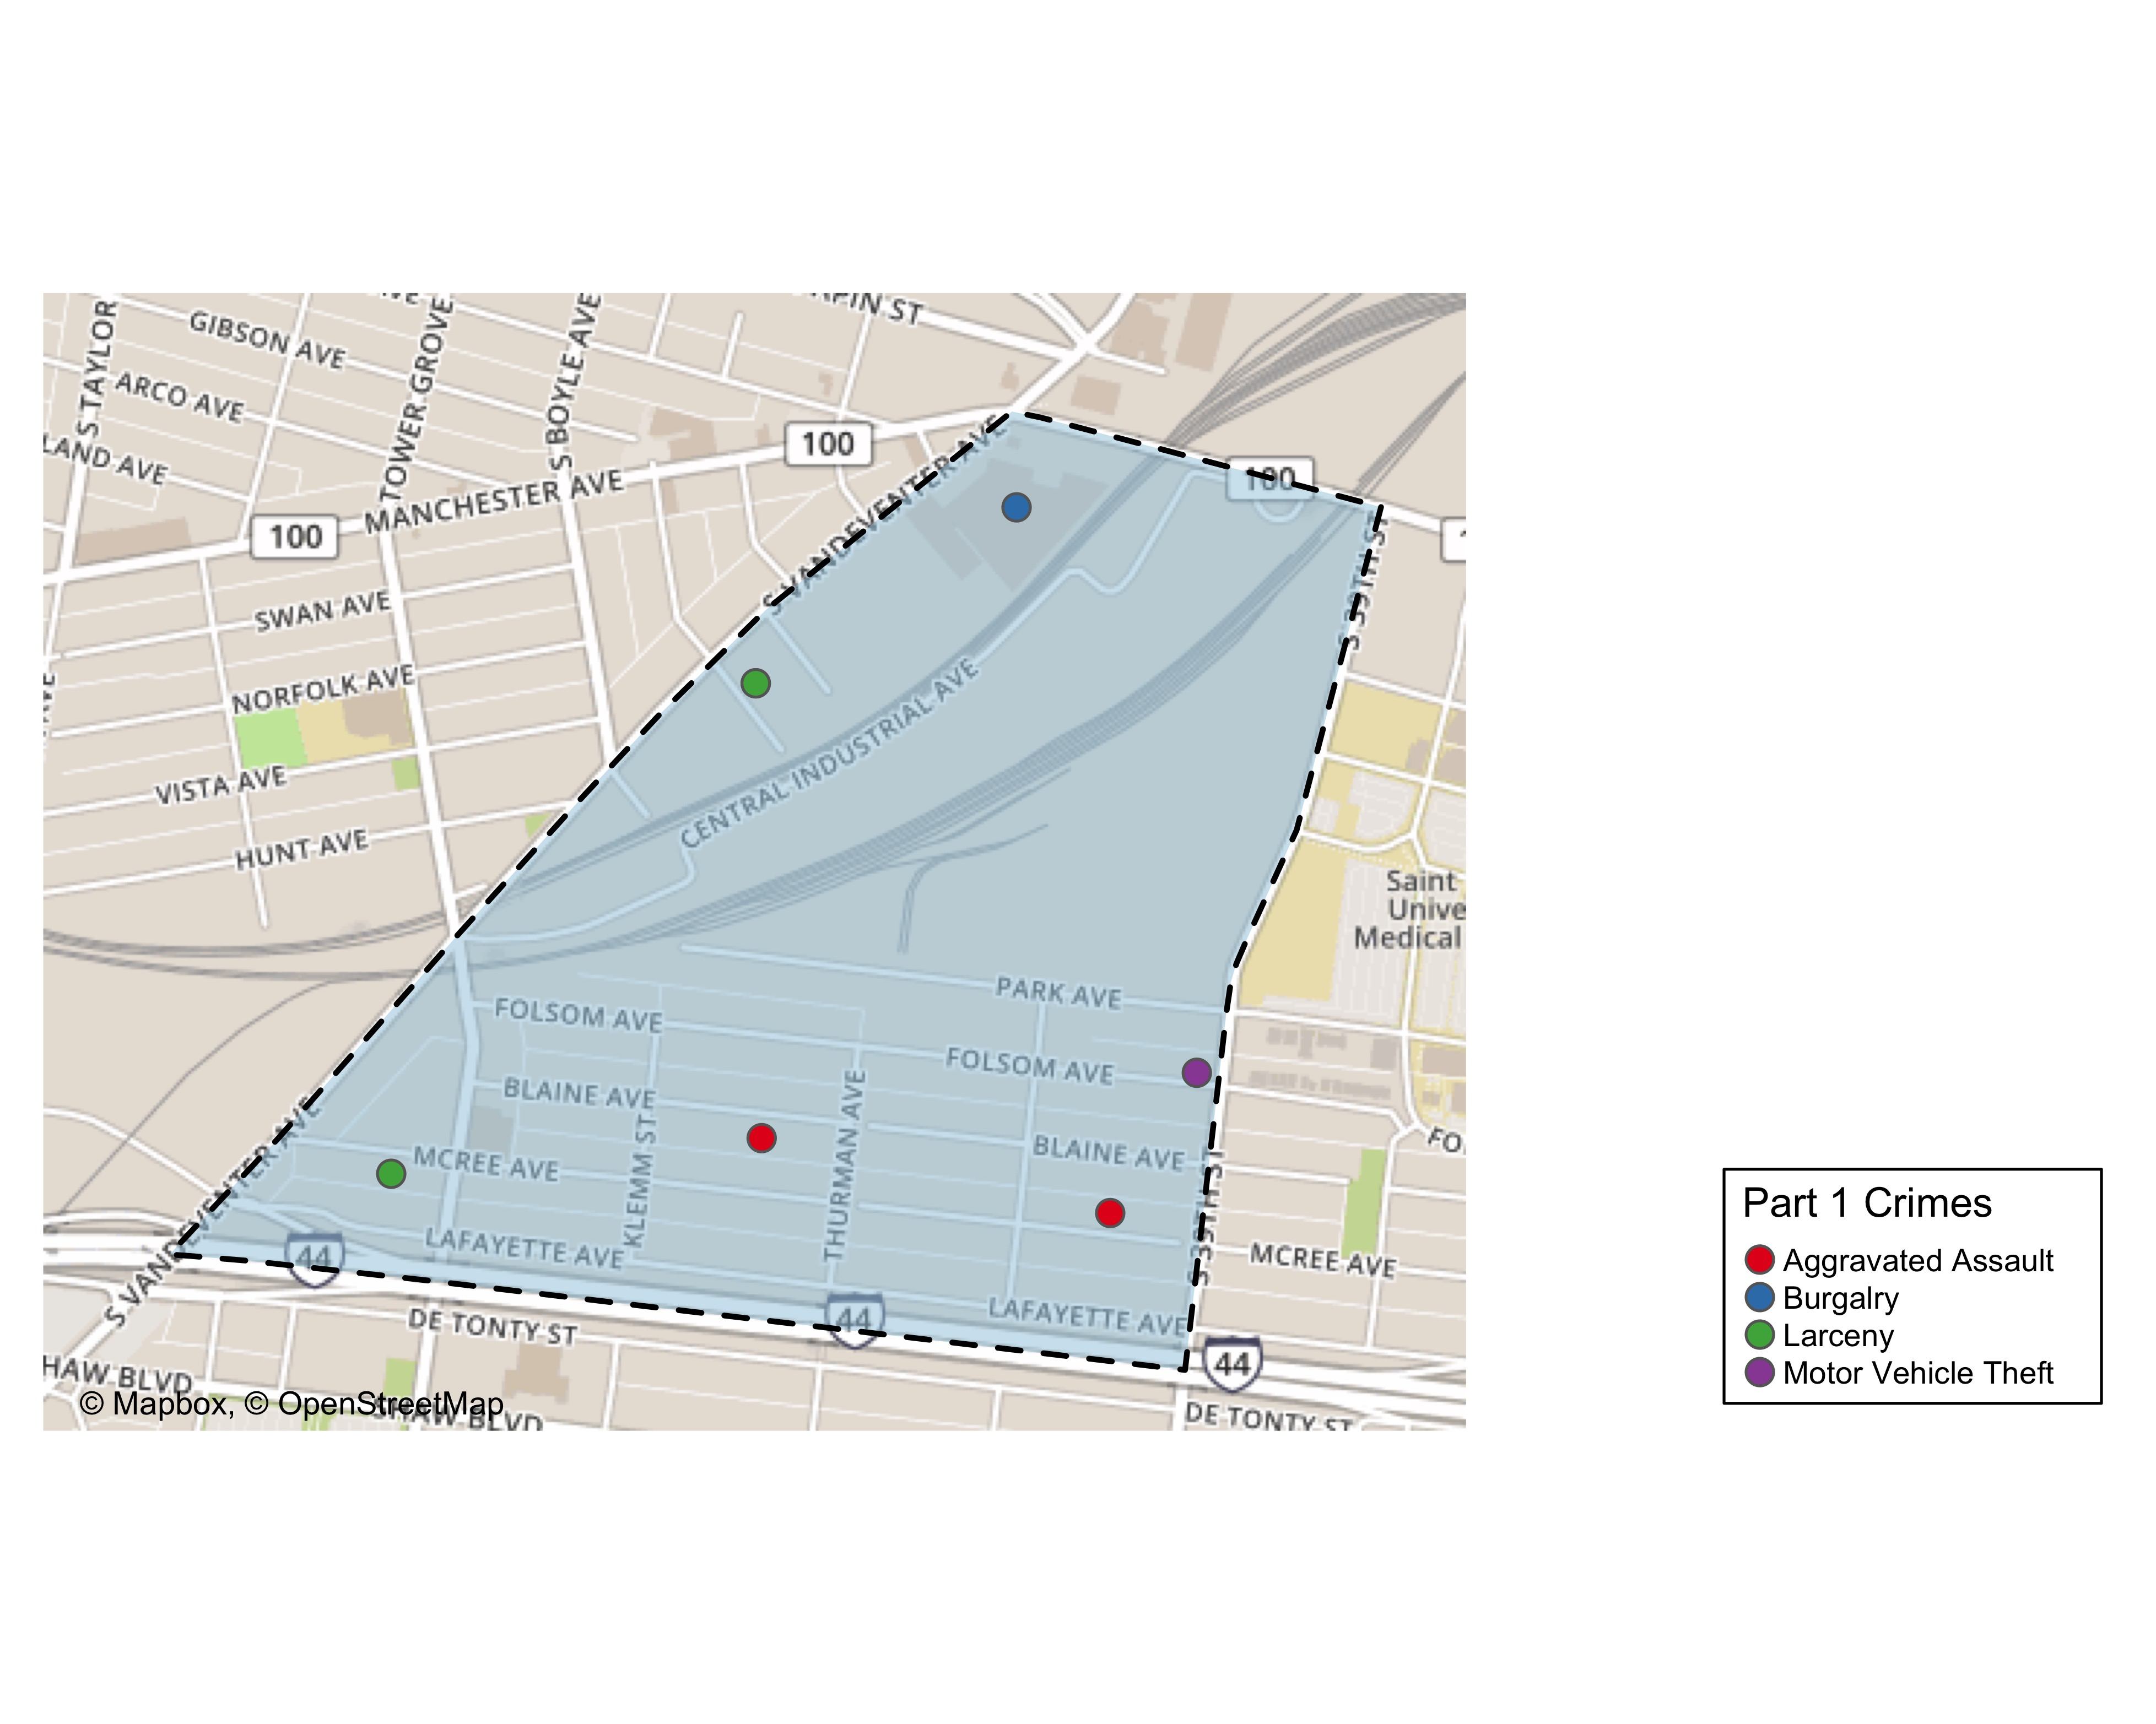
Botanical Heights: Total Crime Map

Slide 10
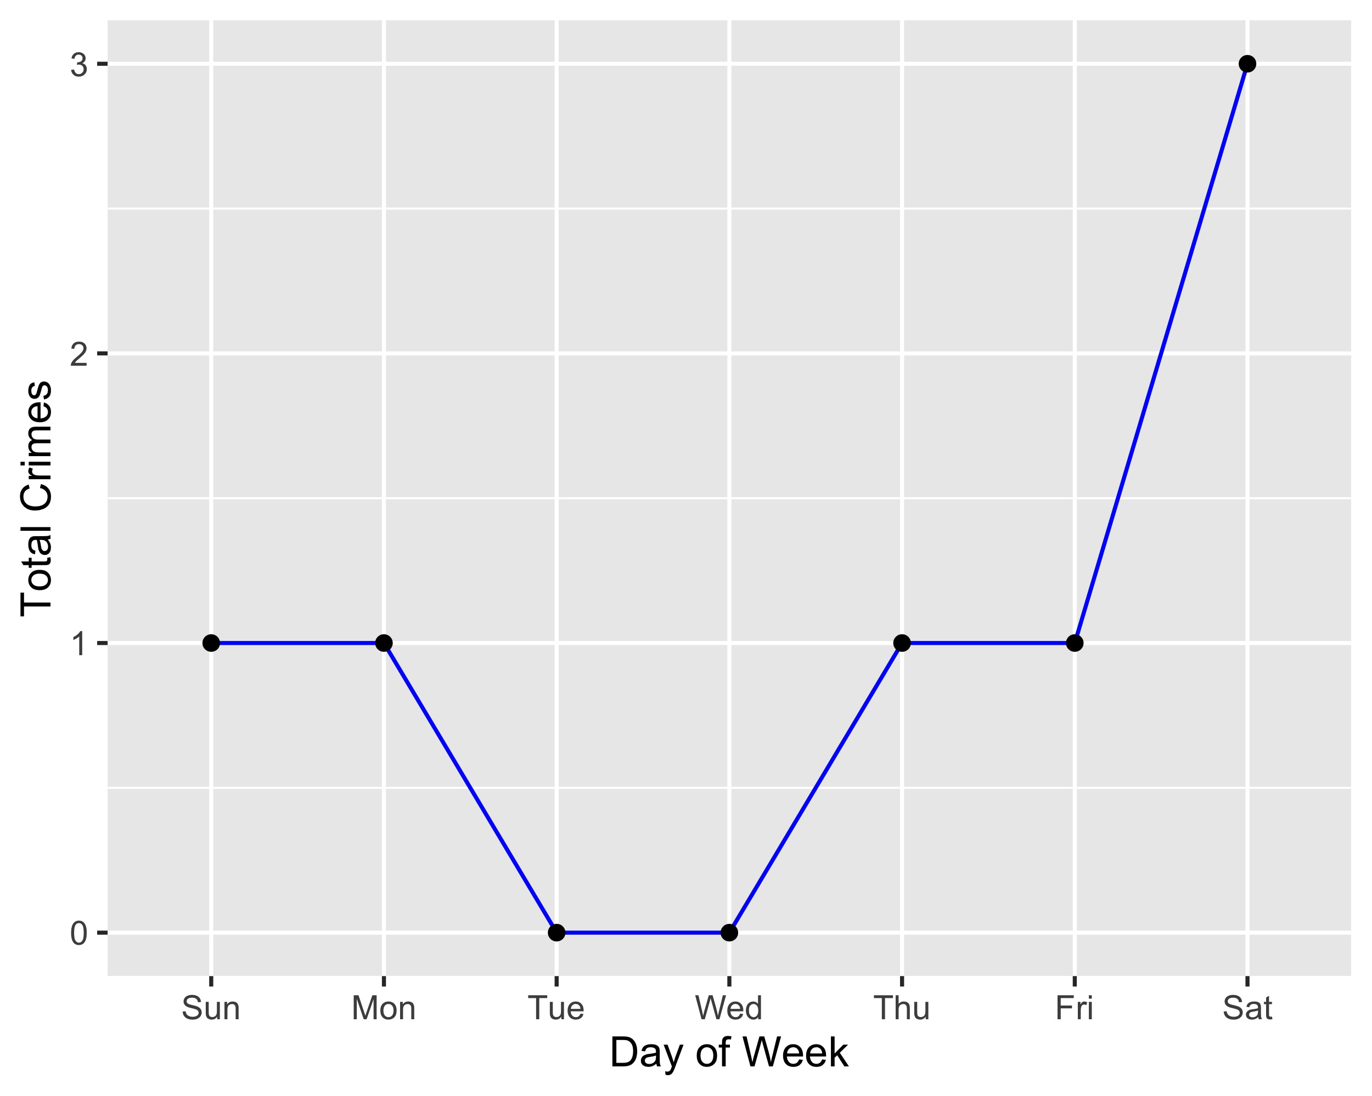
Botanical Heights: Crime by Days of the Week

Slide 11
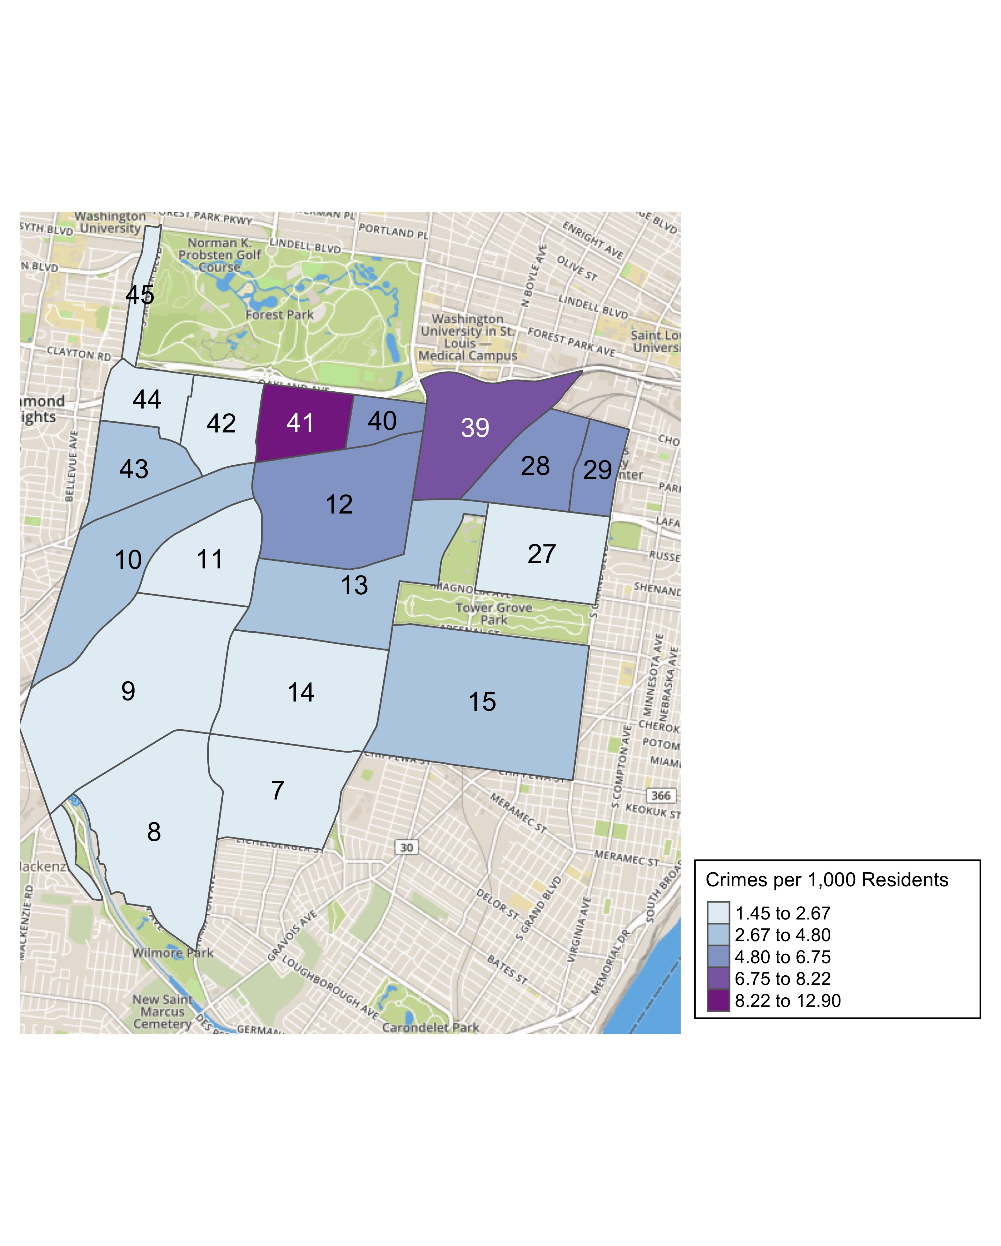
District 2: Crime Rates Map

Slide 12
District 2: Density Map Explanation
There are 23 neighborhoods in District 2. The South Hampton neighborhood is split between District 2 and District 1.
7 total crimes in November 2019
-22% change compared to November 2018 (9 total crimes)
2 crime(s) against persons in November 2019
0% change compared to November 2018 (1 crimes against persons)
76 total crimes in 2019
347% change compared to this time in 2018 (17 total crimes)

Slide 13
Summary Notes: Central West End
117 total crimes in September 2019
34% change compared to September 2018 (87 total crimes)
14 crime(s) against persons in September 2019
56% change compared to September 2018 (9 crimes against persons)
1092 total crimes in 2019
449% change compared to this time in 2018 (199 total crimes)
137 crime(s) against persons in 2019
552% change compared to this time in 2018 (21 crimes against persons)

Slide 14
Central West End: Year to Year Comparison
Part 1 Crimes | Jan | Feb | Mar | Apr | May | Jun | Jul | Aug | Sep | Oct | Nov | Dec | Total
0 | 0 | 0 | 0 | 0 | 0 | 0 | 0 | 0 | 0 | 0 | 0 | 0 | 0
Aggravated Assault | 0 | 0 | 0 | 0 | 0 | 0 | 0 | 0 | 0 | 4 | 4 | 10 | 18
Arson | 0 | 0 | 0 | 0 | 0 | 0 | 0 | 0 | 0 | 0 | 0 | 0 | 0
Burgalry | 0 | 0 | 0 | 0 | 0 | 0 | 0 | 0 | 0 | 7 | 11 | 2 | 20
Homicide | 0 | 0 | 0 | 0 | 0 | 0 | 0 | 0 | 0 | 0 | 0 | 0 | 0
Larceny | 0 | 0 | 0 | 0 | 0 | 0 | 0 | 0 | 0 | 82 | 60 | 49 | 191
Motor Vehicle Theft | 0 | 0 | 0 | 0 | 0 | 0 | 0 | 0 | 0 | 11 | 7 | 8 | 26
Robbery | 0 | 0 | 0 | 0 | 0 | 0 | 0 | 0 | 0 | 8 | 5 | 6 | 19
Total | 0 | 0 | 0 | 0 | 0 | 0 | 0 | 0 | 0 | 112 | 87 | 75 | 274
Part 1 Crimes | Jan | Feb | Mar | Apr | May | Jun | Jul | Aug | Sep | Oct | Nov | Total
Aggravated Assault | 9 | 4 | 10 | 2 | 8 | 13 | 4 | 11 | 3 | 8 | 4 | 76
Arson | 0 | 0 | 1 | 0 | 0 | 0 | 0 | 0 | 0 | 0 | 0 | 1
Burgalry | 3 | 5 | 5 | 9 | 13 | 8 | 13 | 18 | 8 | 8 | 8 | 98
Homicide | 0 | 0 | 0 | 0 | 0 | 0 | 0 | 0 | 0 | 0 | 0 | 0
Larceny | 45 | 66 | 65 | 65 | 72 | 56 | 75 | 81 | 63 | 90 | 78 | 756
Motor Vehicle Theft | 11 | 7 | 3 | 11 | 12 | 9 | 5 | 11 | 9 | 5 | 17 | 100
Robbery | 5 | 5 | 2 | 6 | 7 | 3 | 4 | 8 | 3 | 8 | 10 | 61
Total | 73 | 87 | 86 | 93 | 112 | 89 | 101 | 129 | 86 | 119 | 117 | 1,092

Slide 15
Central West End: Summary Tables
Part 1 Crimes | Number of Crimes
Aggravated Assault | 4
Burgalry | 8
Larceny | 78
Motor Vehicle Theft | 17
Robbery | 10
Total | 117
Day of the Week | Number of Crimes
Sun | 15
Mon | 10
Tue | 12
Wed | 24
Thu | 14
Fri | 30
Sat | 12
Total | 117
Crimes Against Persons | Number of Crimes
FALSE | 103
TRUE | 14
Total | 117
Time of Day | Number of Crimes
Day | 101
Night | 16
Total | 117

Slide 16
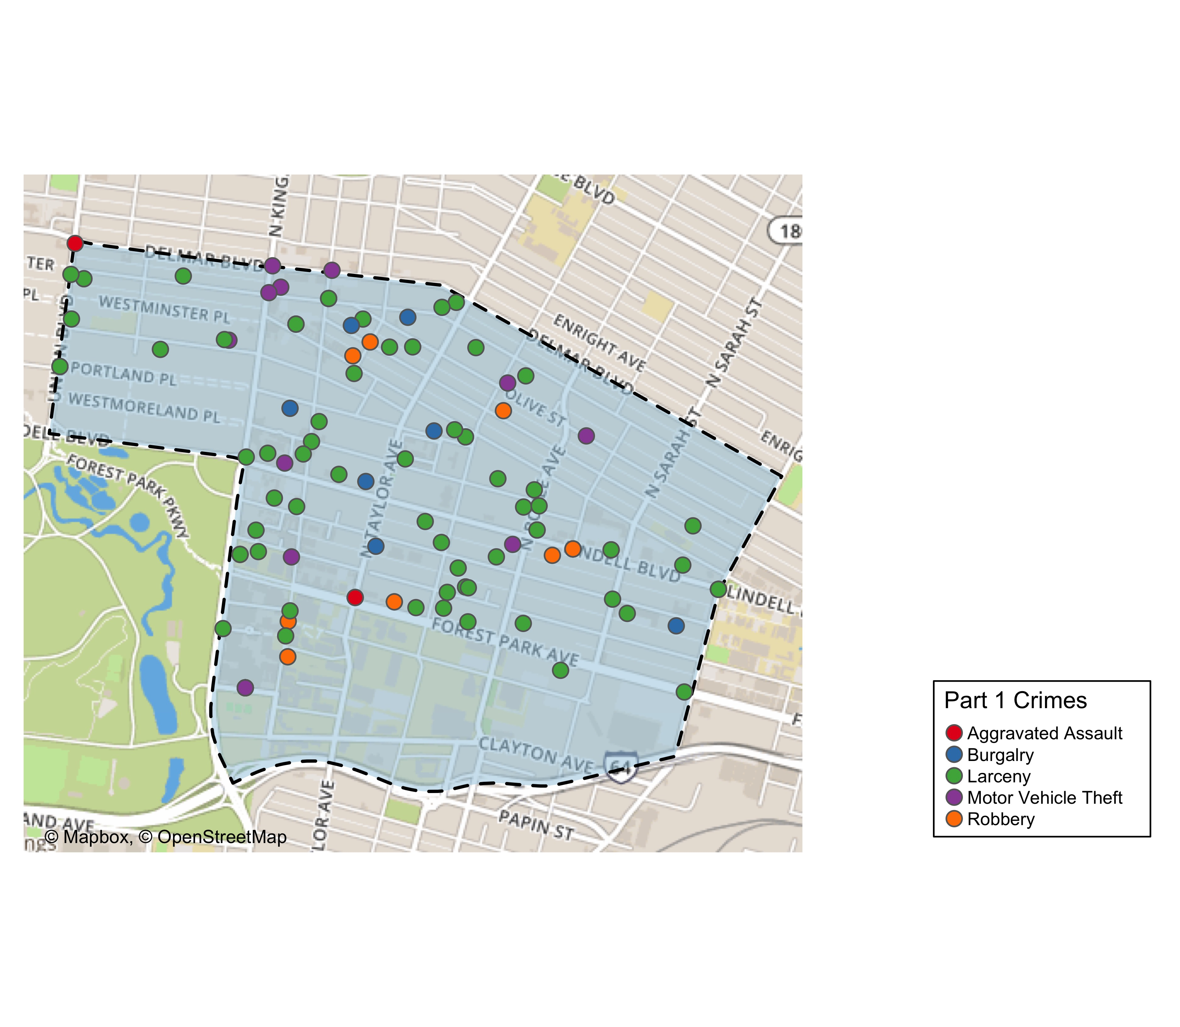
Central West End: Total Crime Map

Slide 17
Washington University Medical Campus: Summary Notes
15 total crimes in November 2019
114% change compared to November 2018 (7 total crimes)
3 crime(s) against persons in November 2019
200% change compared to November 2018 (1 crimes against persons)
120 total crimes in 2019
700% change compared to this time in 2018 (15 total crimes)
24 crime(s) against persons in 2019
2 300% change compared to this time in 2018 (1 crimes against persons)

Slide 18
Washington University Medical Campus: Year to Year Comparison
Part 1 Crimes | Jan | Feb | Mar | Apr | May | Jun | Jul | Aug | Sep | Oct | Nov | Dec | Total
0 | 0 | 0 | 0 | 0 | 0 | 0 | 0 | 0 | 0 | 0 | 0 | 0 | 0
Aggravated Assault | 0 | 0 | 0 | 0 | 0 | 0 | 0 | 0 | 0 | 0 | 0 | 1 | 1
Arson | 0 | 0 | 0 | 0 | 0 | 0 | 0 | 0 | 0 | 0 | 0 | 0 | 0
Burgalry | 0 | 0 | 0 | 0 | 0 | 0 | 0 | 0 | 0 | 0 | 0 | 0 | 0
Homicide | 0 | 0 | 0 | 0 | 0 | 0 | 0 | 0 | 0 | 0 | 0 | 0 | 0
Larceny | 0 | 0 | 0 | 0 | 0 | 0 | 0 | 0 | 0 | 5 | 3 | 8 | 16
Motor Vehicle Theft | 0 | 0 | 0 | 0 | 0 | 0 | 0 | 0 | 0 | 3 | 3 | 0 | 6
Robbery | 0 | 0 | 0 | 0 | 0 | 0 | 0 | 0 | 0 | 0 | 1 | 0 | 1
Total | 0 | 0 | 0 | 0 | 0 | 0 | 0 | 0 | 0 | 8 | 7 | 9 | 24
Part 1 Crimes | Jan | Feb | Mar | Apr | May | Jun | Jul | Aug | Sep | Oct | Nov | Total
Aggravated Assault | 4 | 1 | 1 | 0 | 0 | 2 | 0 | 5 | 3 | 0 | 1 | 17
Arson | 0 | 0 | 0 | 0 | 0 | 0 | 0 | 0 | 0 | 0 | 0 | 0
Burgalry | 0 | 0 | 0 | 0 | 0 | 0 | 0 | 1 | 0 | 0 | 0 | 1
Homicide | 0 | 0 | 0 | 0 | 0 | 0 | 0 | 0 | 0 | 0 | 0 | 0
Larceny | 7 | 8 | 6 | 9 | 9 | 6 | 8 | 4 | 11 | 6 | 8 | 82
Motor Vehicle Theft | 2 | 0 | 1 | 2 | 1 | 0 | 0 | 1 | 2 | 0 | 4 | 13
Robbery | 0 | 0 | 0 | 1 | 0 | 1 | 0 | 1 | 1 | 1 | 2 | 7
Total | 13 | 9 | 8 | 12 | 10 | 9 | 8 | 12 | 17 | 7 | 15 | 120

Slide 19
Washington University Medical Campus: Summary Tables
Part 1 Crimes | Number of Crimes
Aggravated Assault | 1
Larceny | 8
Motor Vehicle Theft | 4
Robbery | 2
Total | 15
Time of Day | Number of Crimes
Day | 15
Total | 15
Type of Larceny | Number of Crimes
All Other | 1
From Building | 6
From Motor Vehicle | 1
Total | 8
Monetary Value | Number of Crimes
$500 - $24,999 | 3
Under $500 | 5
Total | 8

Slide 20
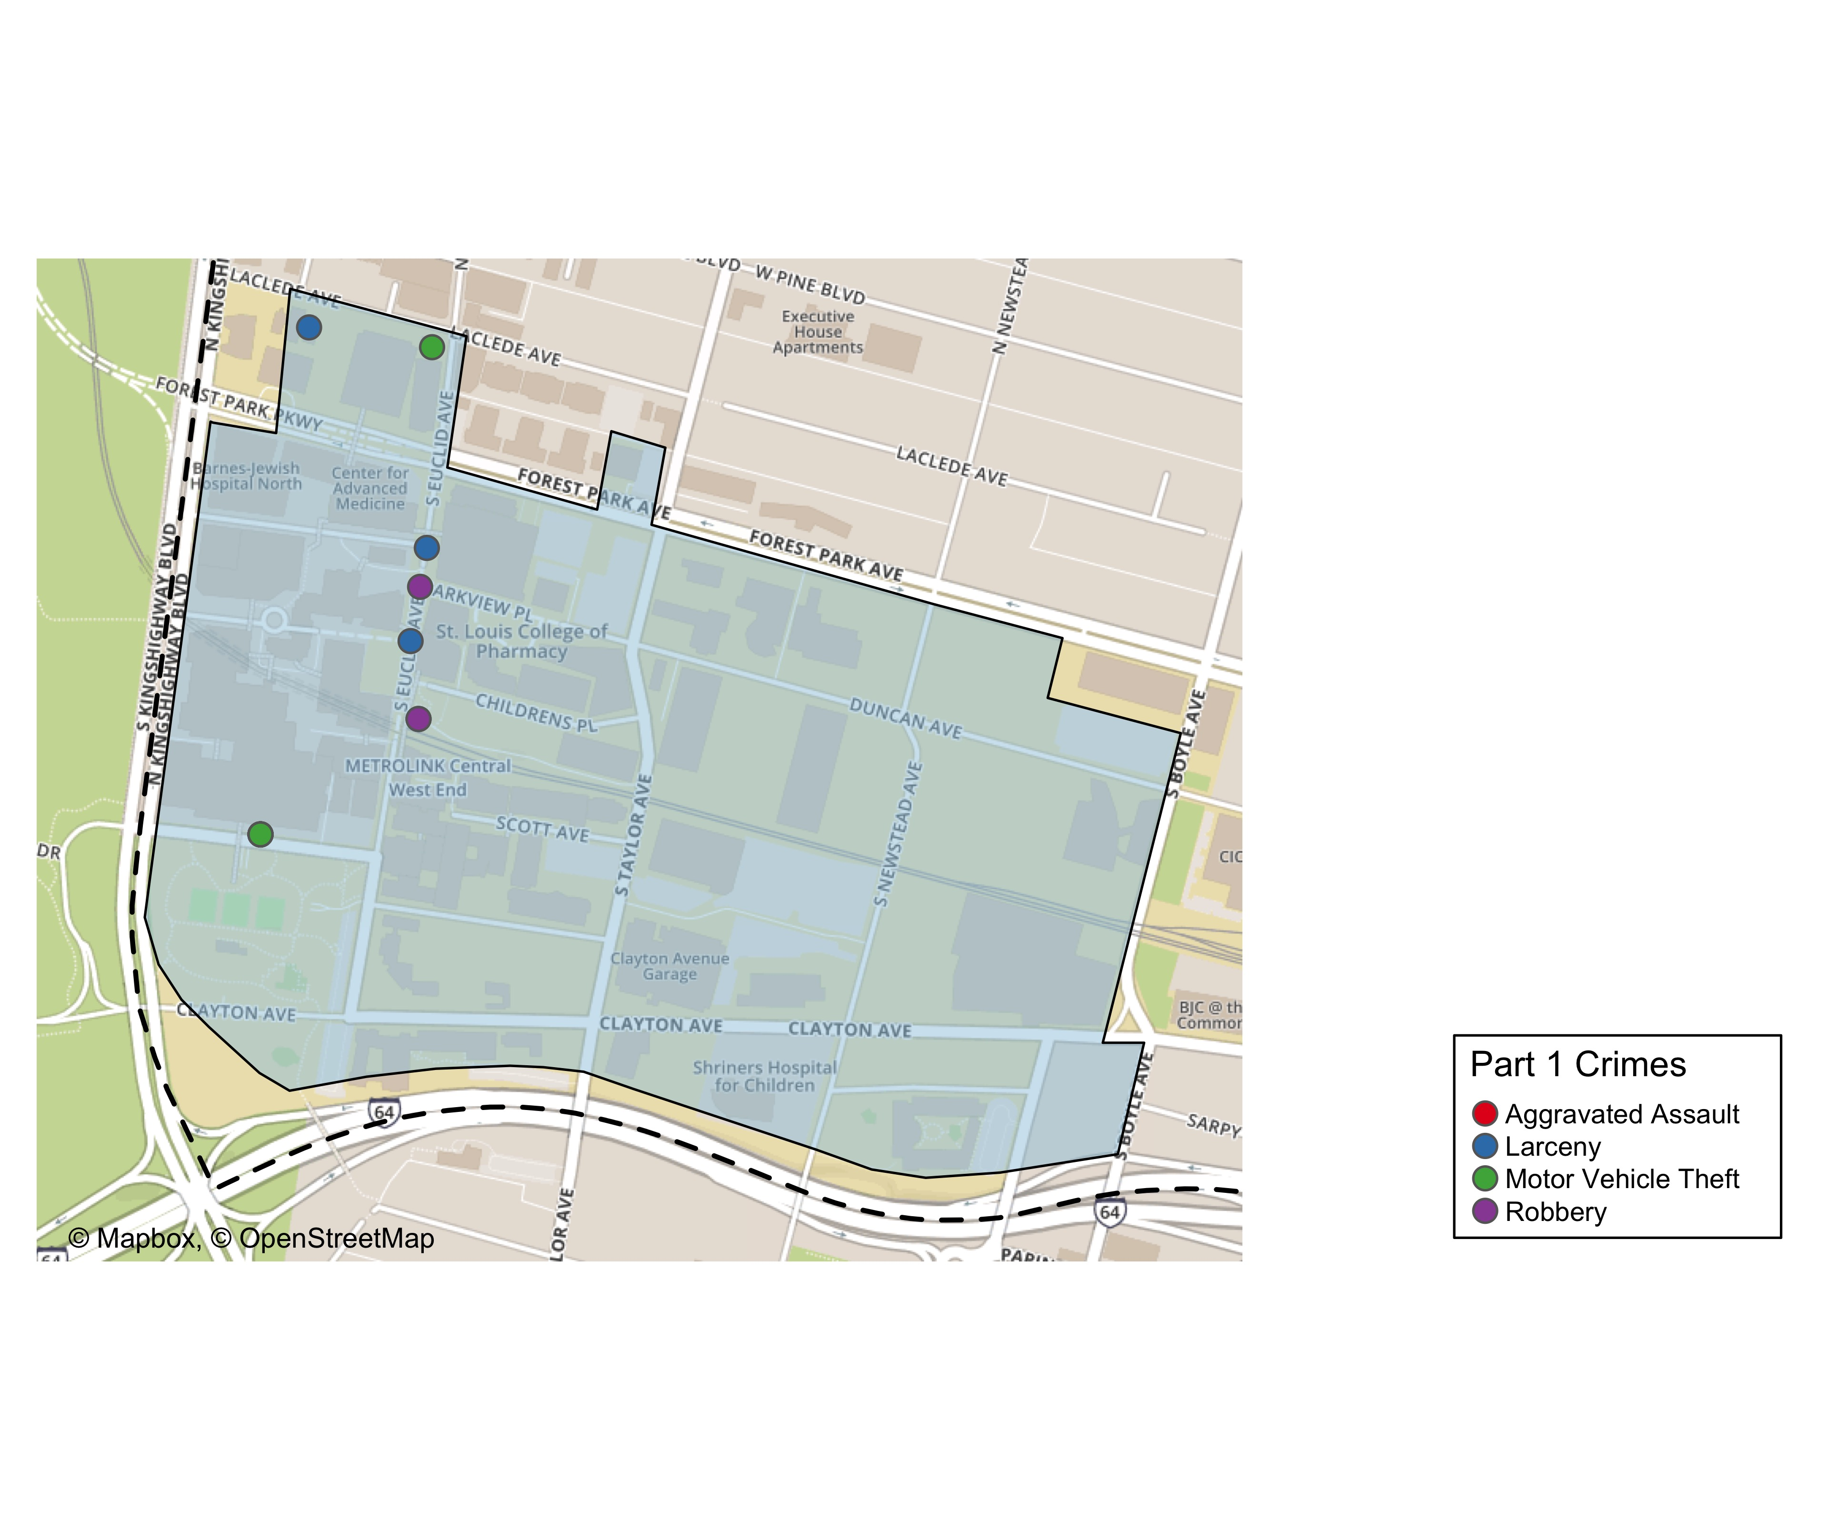
Washington University Medical Center: Total Crime Map

Slide 21
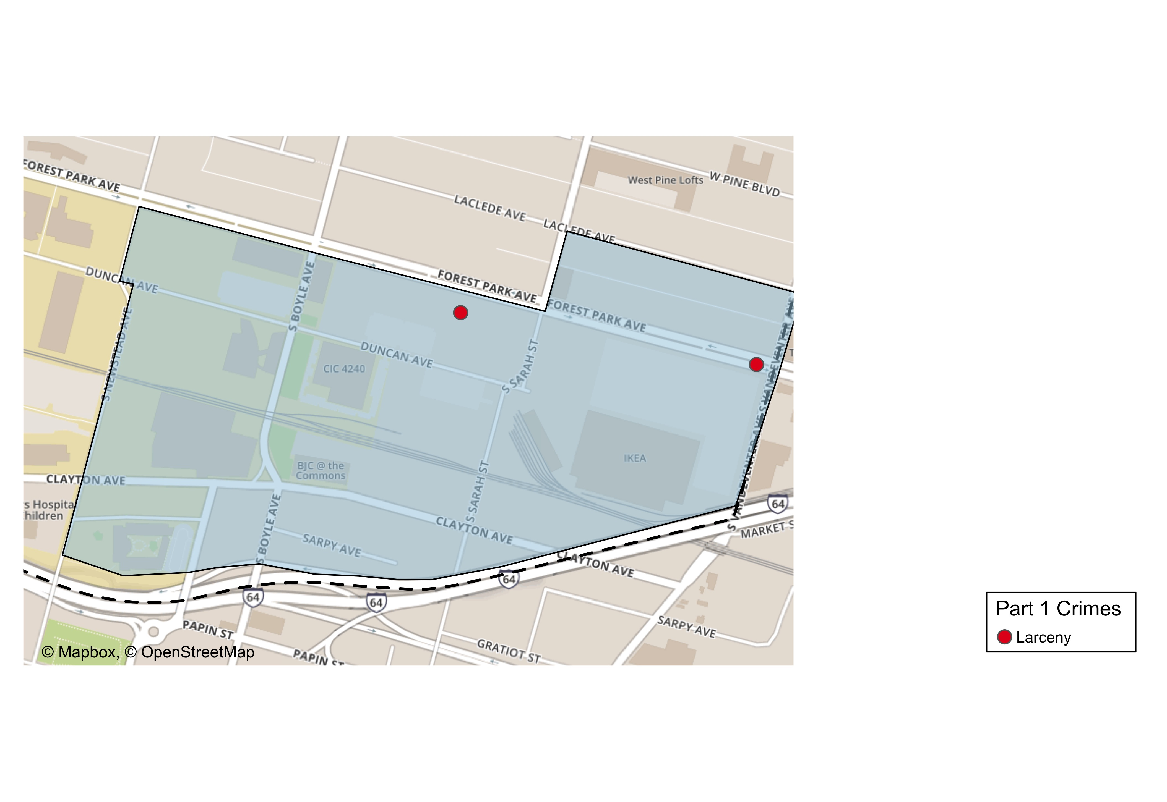
Cortex: Total Crime Map

Slide 22
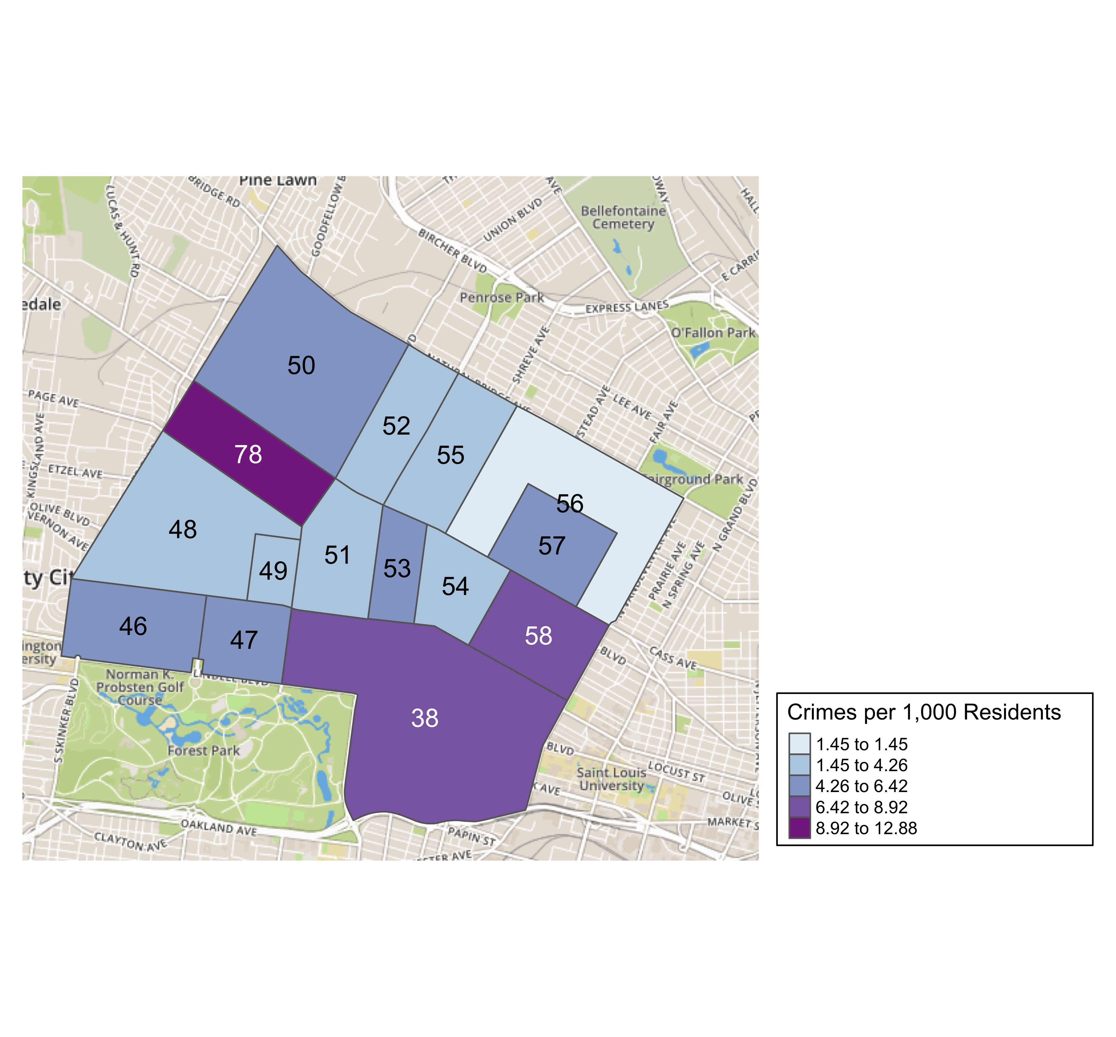
District 5: Crime Rates Map

Slide 23
District 5: Density Map Explanation
There are 15 neighborhoods in District 5.
The minimum number of crimes in one neighborhood was 3 (Visitation Park)
The maximum number of crimes in one neighborhood was 117 (Central West End)
The mean number of crimes in one neighborhood was 23.27
The minimum rate of crimes in one neighborhood was 1.45 (Greater Ville)
The maximum rate of crimes in one neighborhood was 12.88 (Hamilton Heights)
The mean rate of crimes in one neighborhood was 5.49

Slide 24
Forest Park Southeast: Neighborhood Detail
Appendix 1

Slide 25
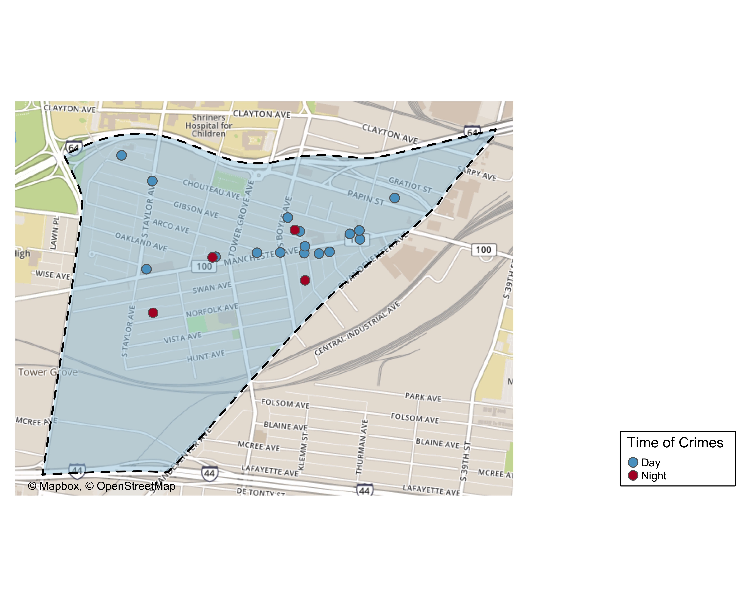
Forest Park Southeast: Time of Crimes Map

Slide 26
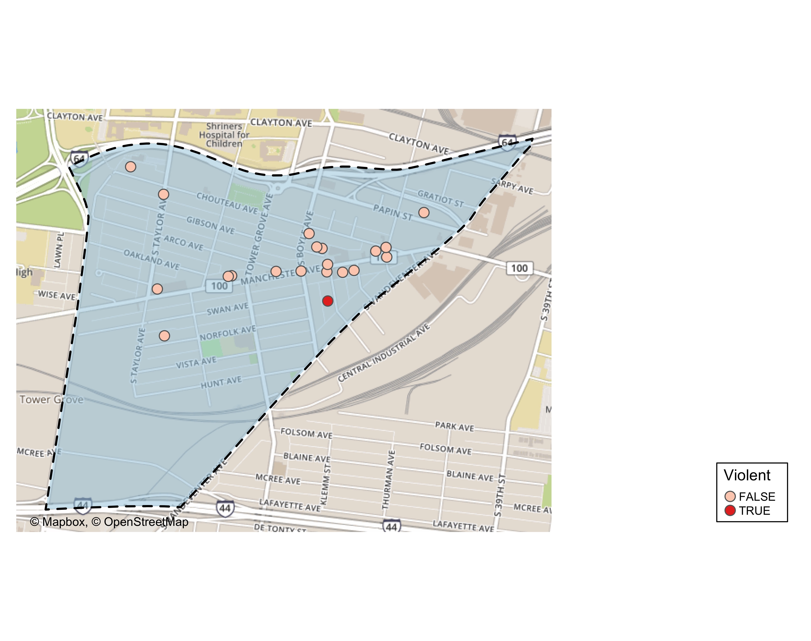
Forest Park Southeast: Violent Crime Map

Slide 27
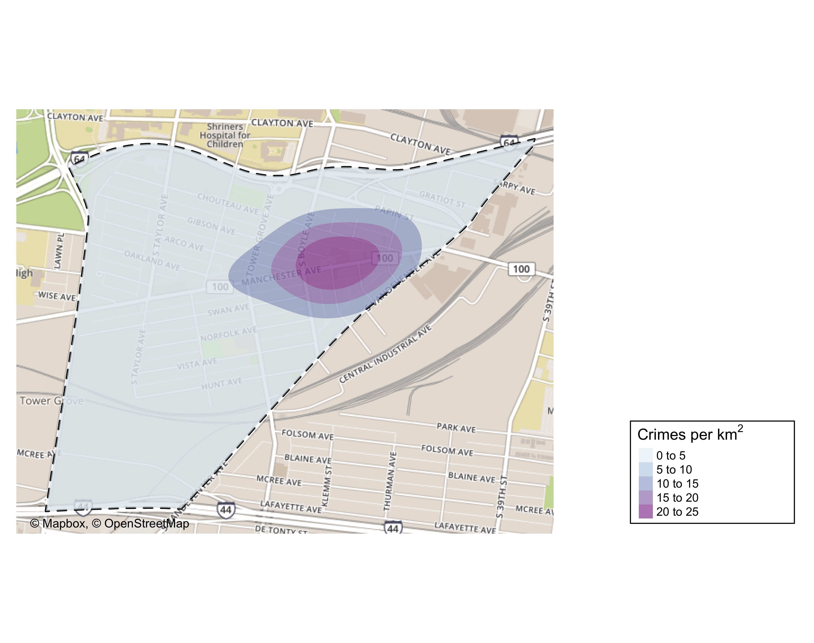
Forest Park Southeast: Crime Density Map

Slide 28
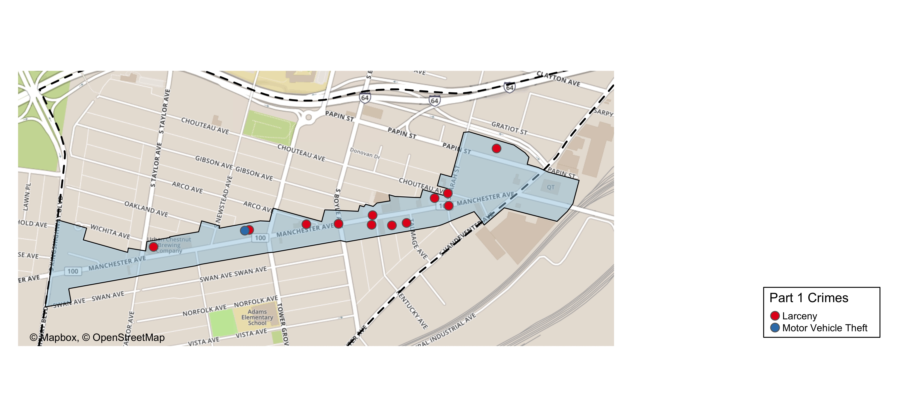
Grove Community Improvement District: Total Crime Map

Slide 29
Forest Park Southeast: Larceny Breakdown
Day of the Week | Number of Crimes
Sun | 3
Mon | 5
Tue | 2
Wed | 4
Thu | 1
Fri | 2
Sat | 0
Total | 17
Time of Day | Number of Crimes
Day | 17
Total | 17
Type of Larceny | Number of Crimes
All Other | 1
From Building | 3
From Motor Vehicle | 12
Motor Vehicle Parts | 1
Total | 17
Monetary | Number of Crimes
$500 - $24,999 | 6
Under $500 | 11
Total | 17

Slide 30
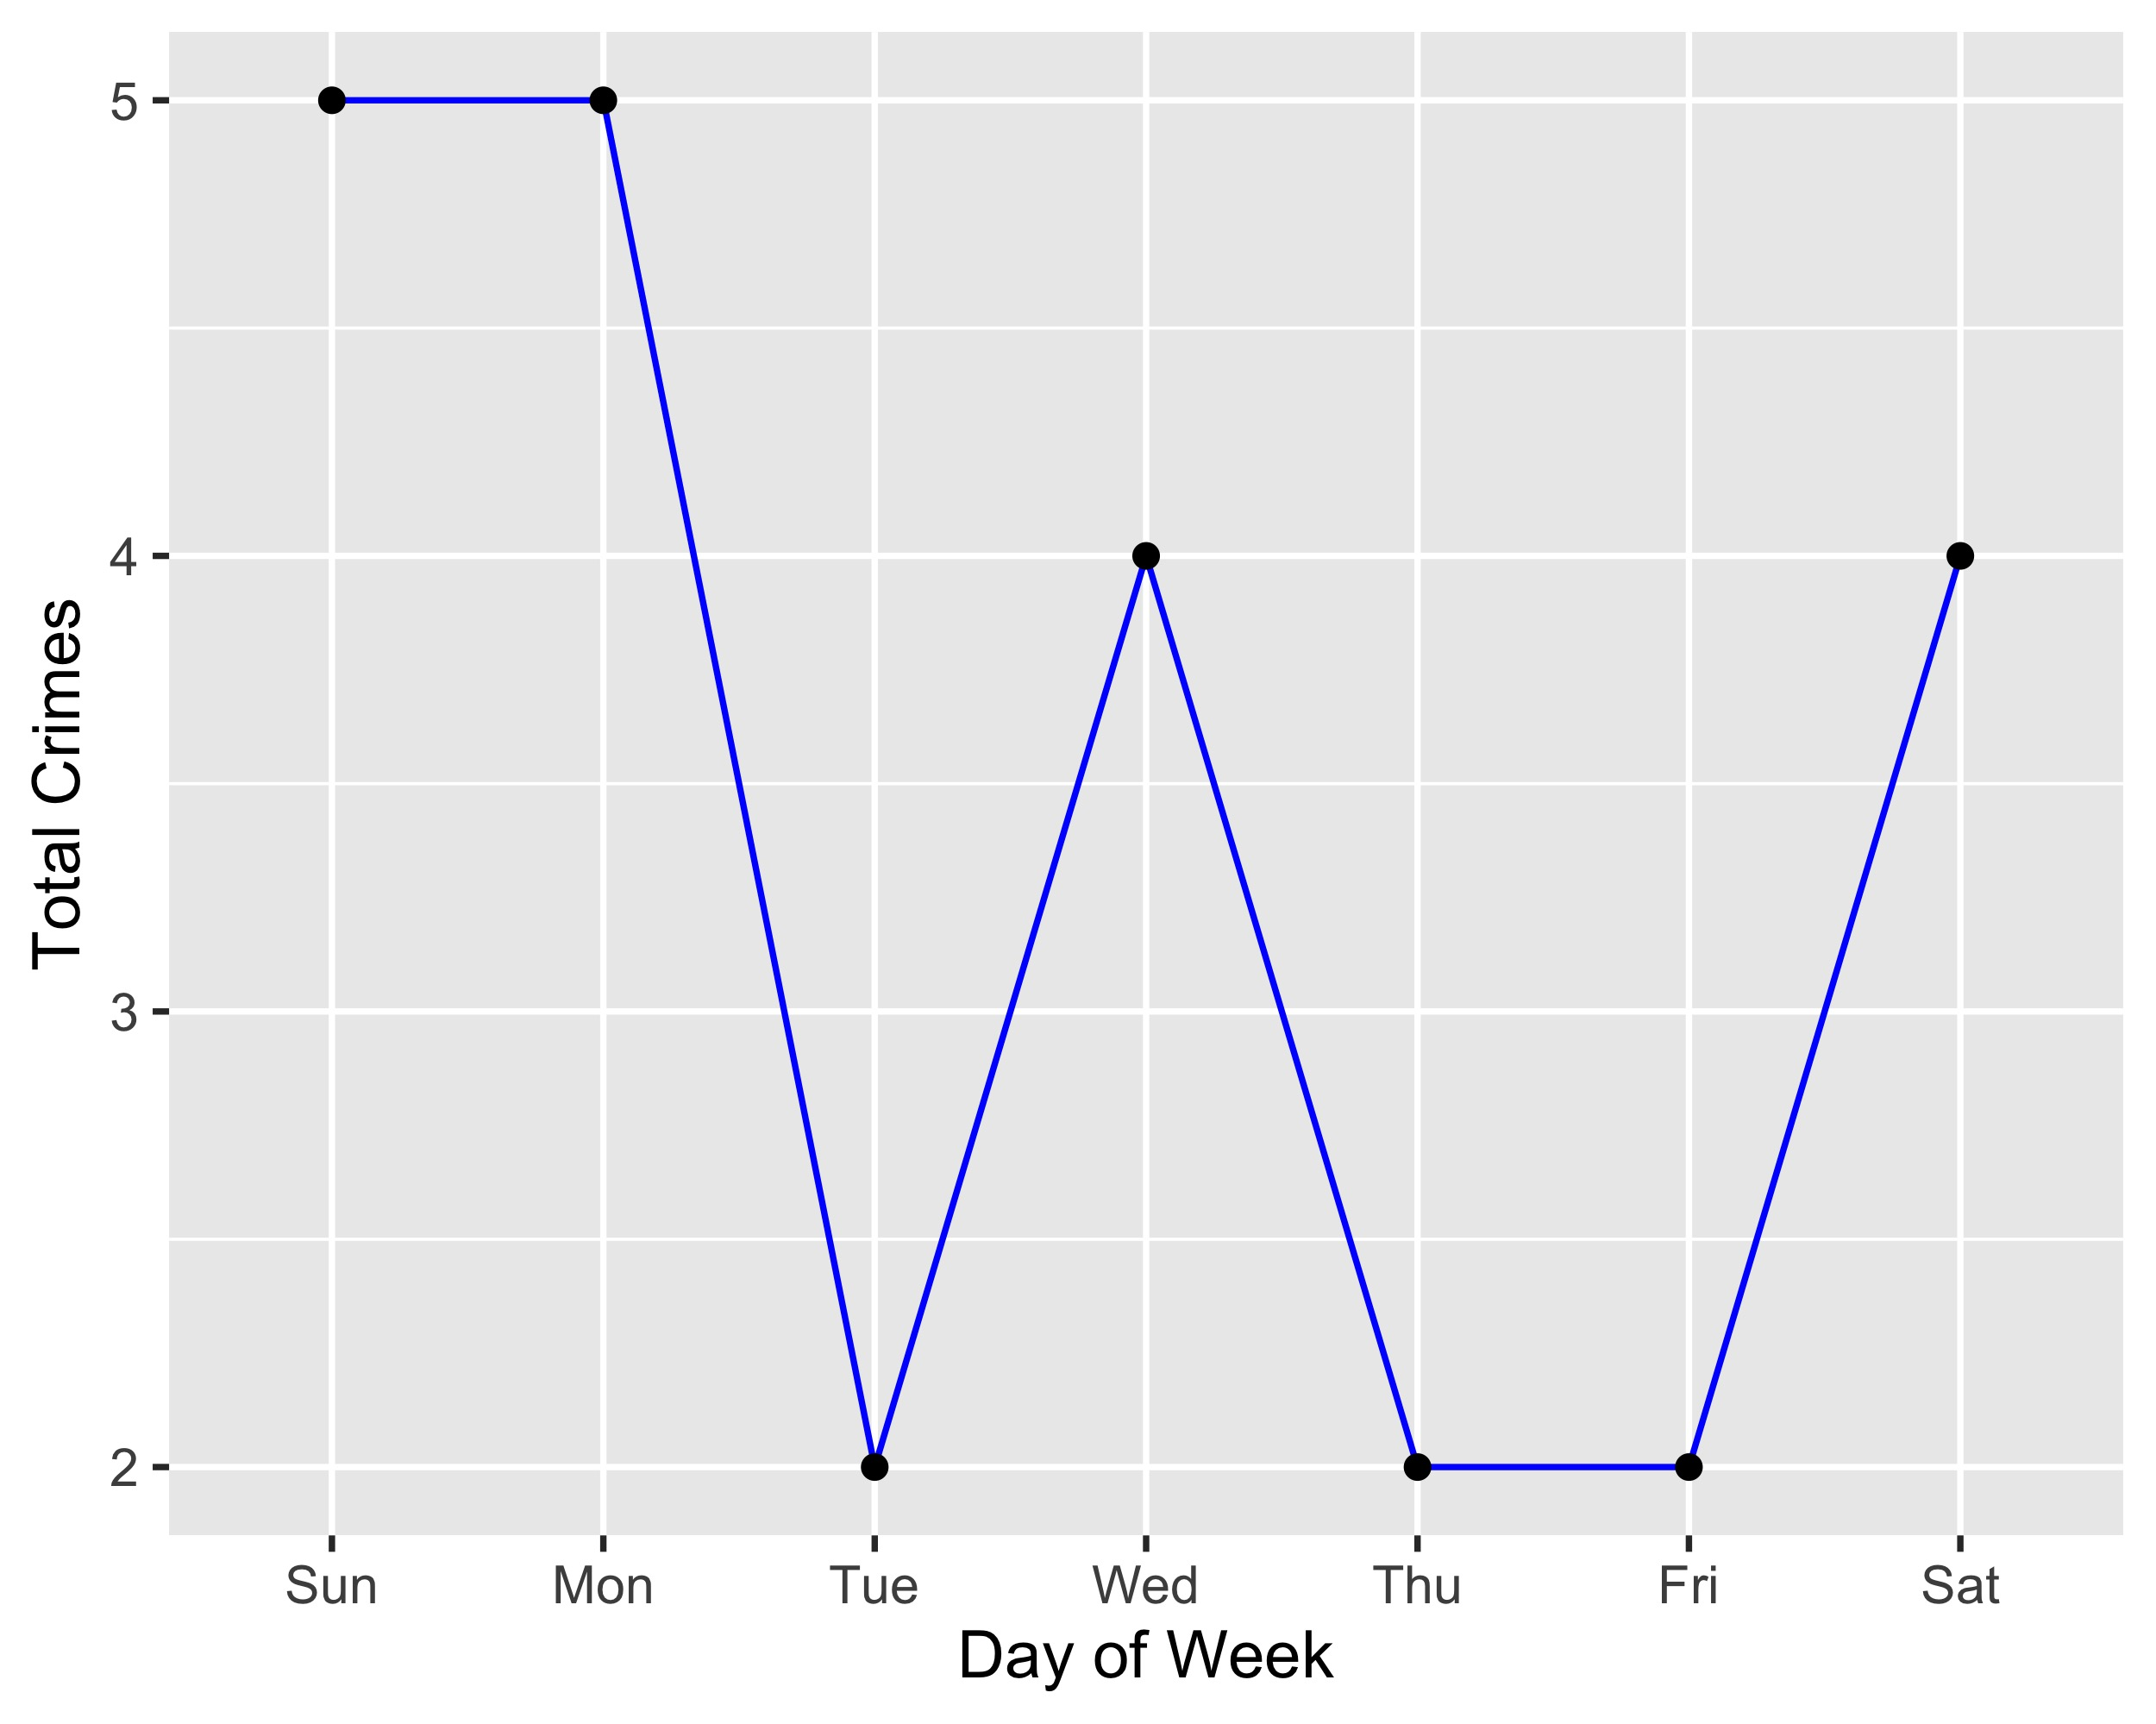
Forest Park Southeast: Total Crimes by Days of the Week

Slide 31
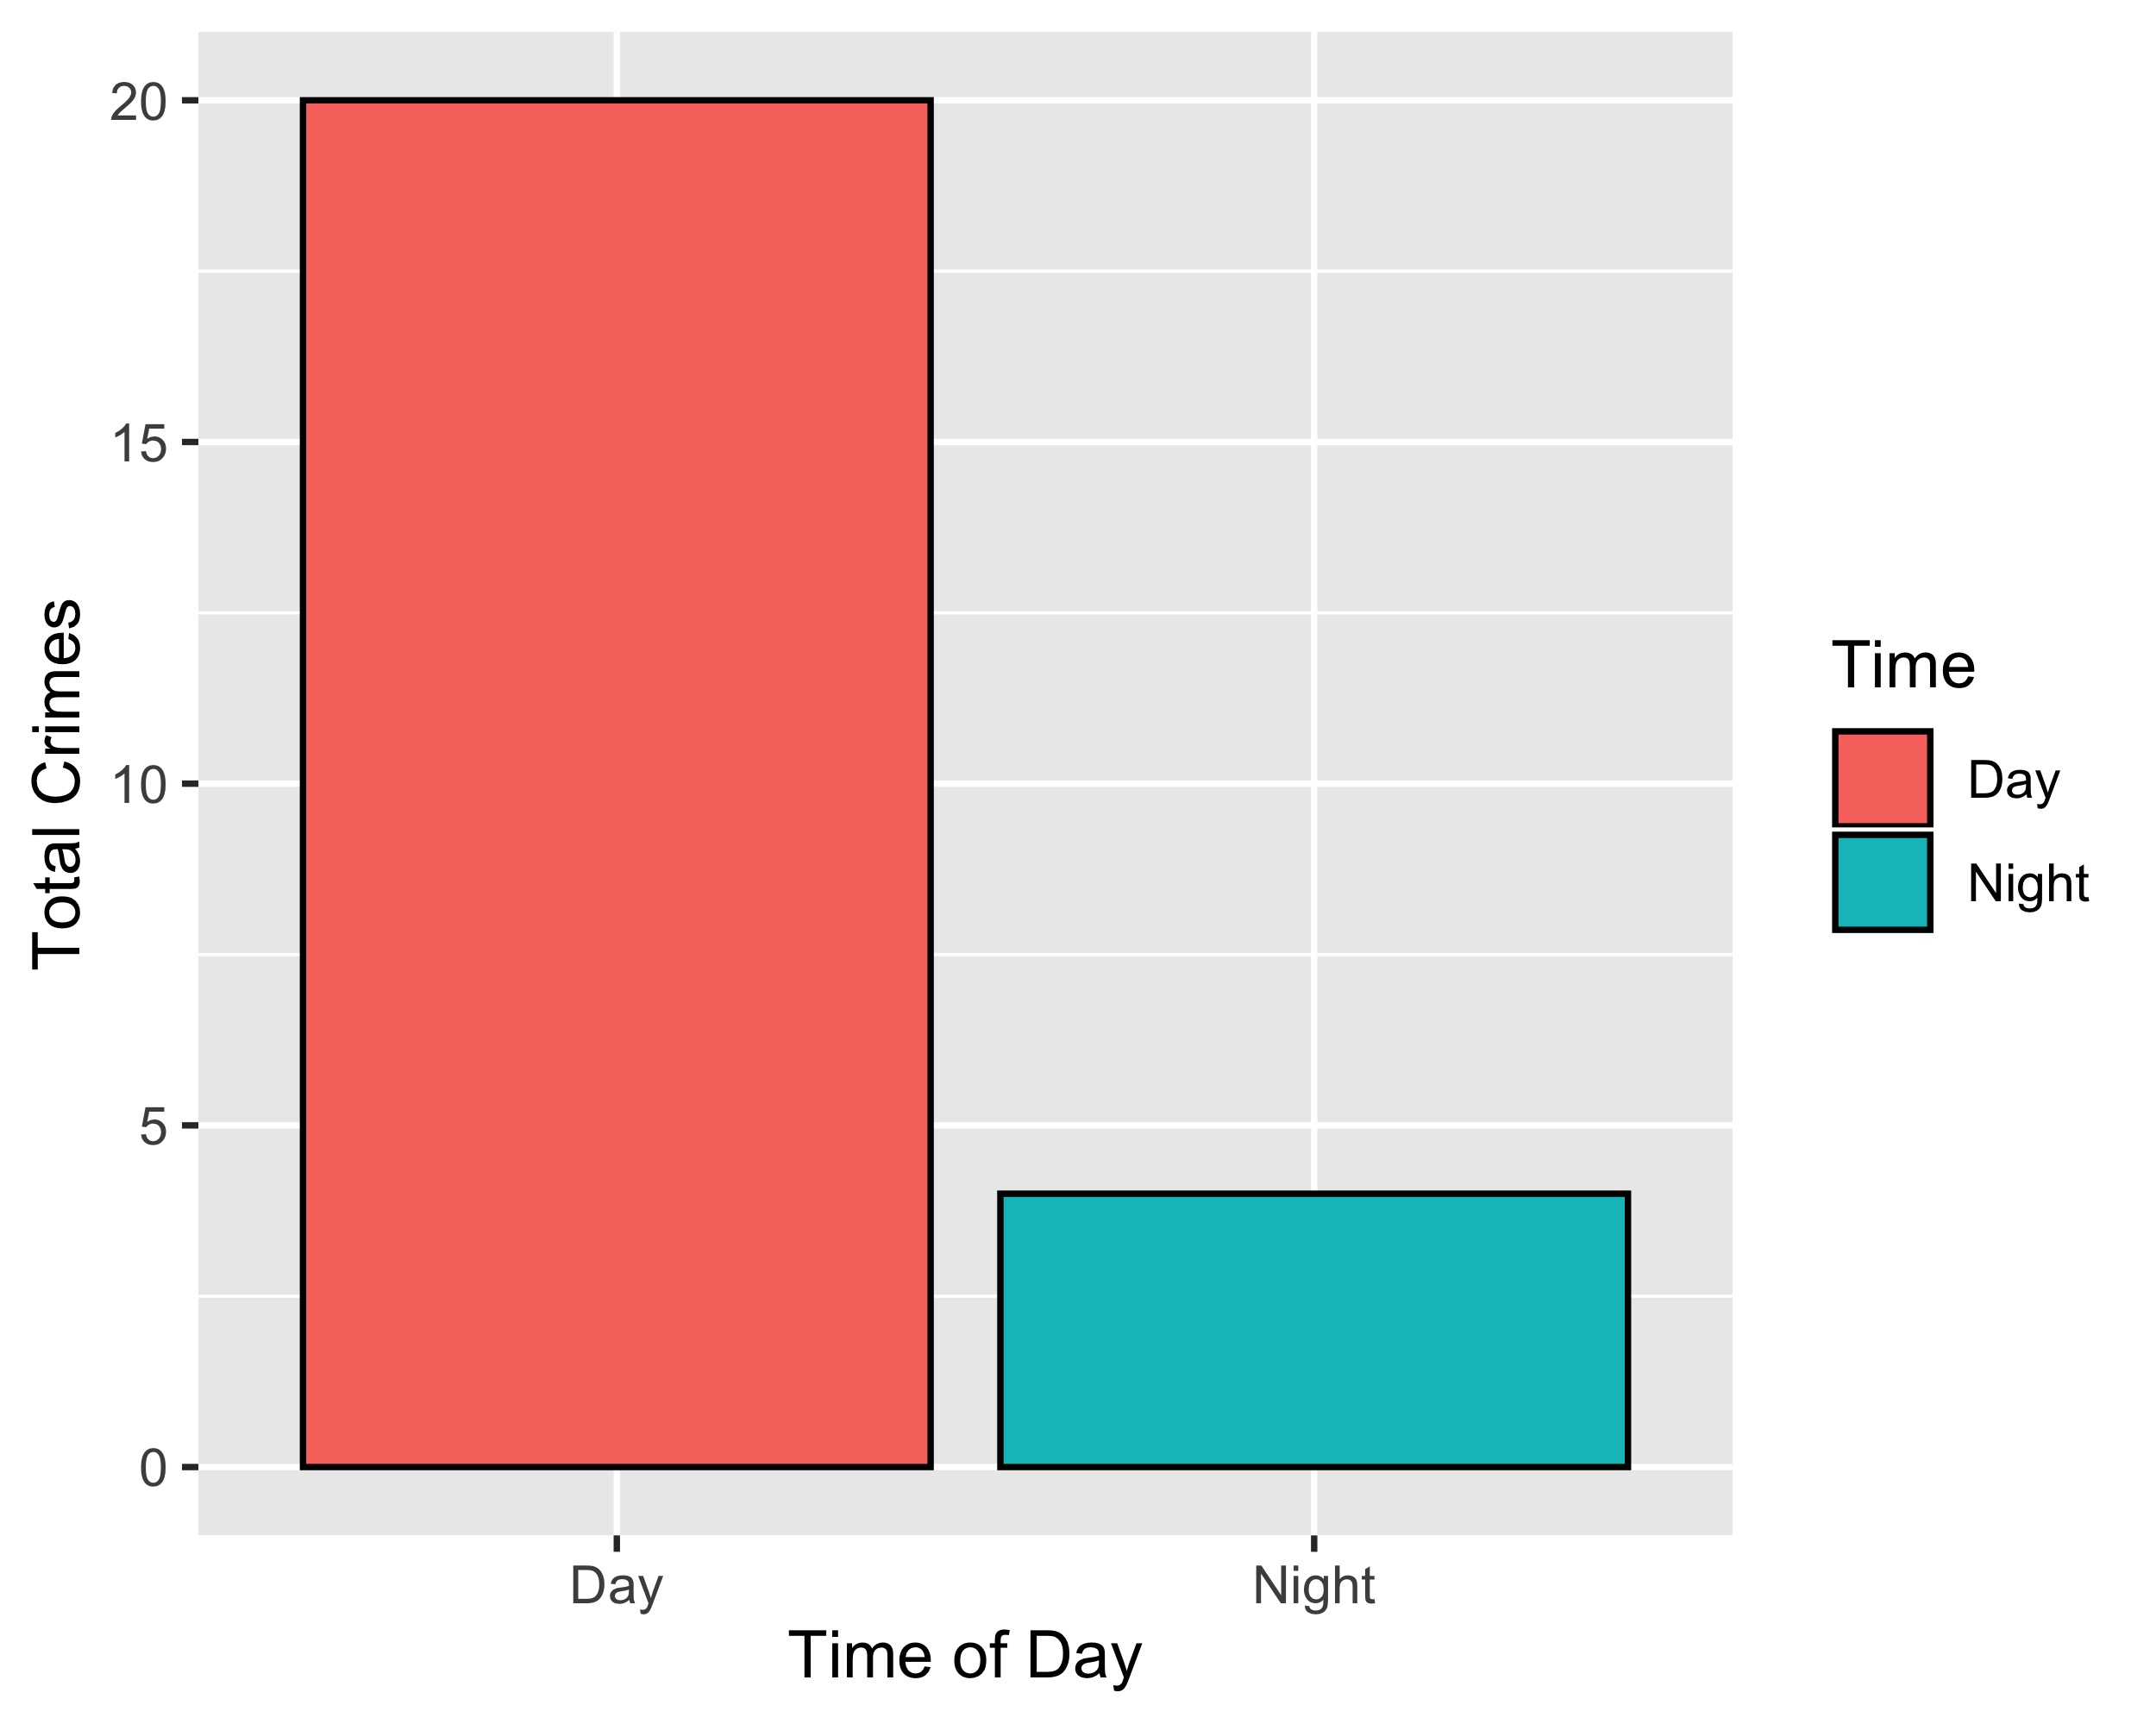
Forest Park Southeast: Crimes by Time of Day

Slide 32
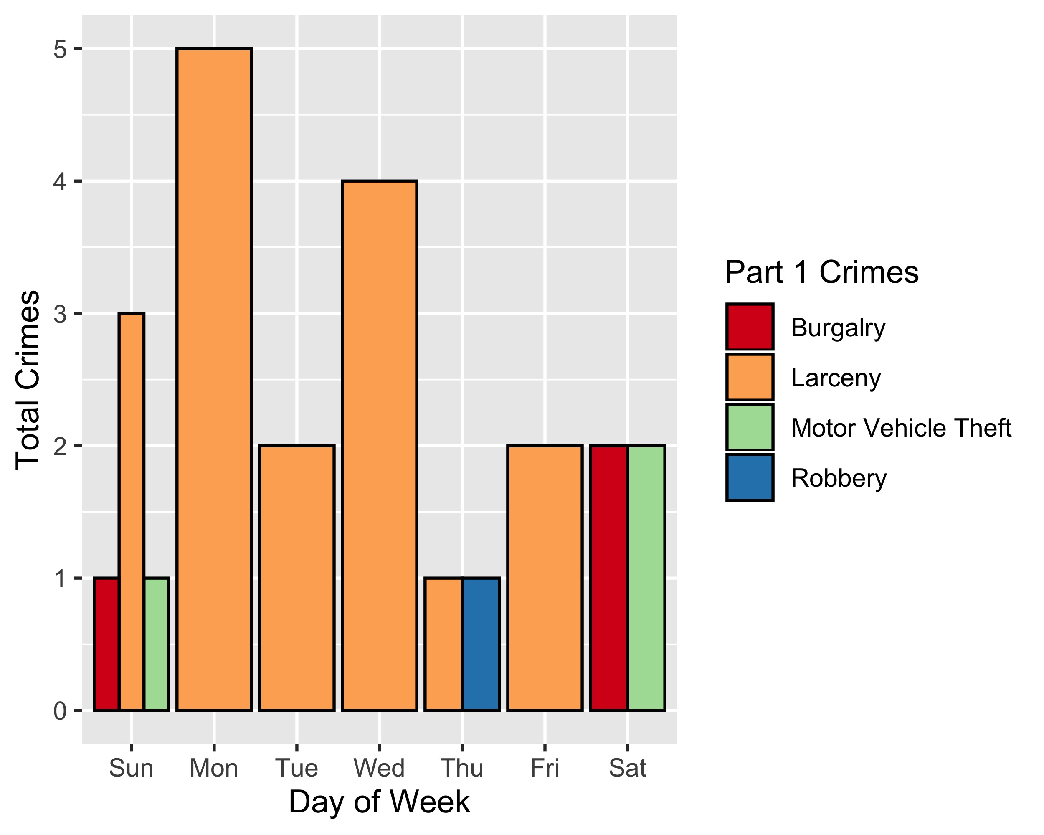
Forest Park Southeast: Crimes by Day & Category

Slide 33
Central West End: Neighborhood Detail
Appendix 2

Slide 34
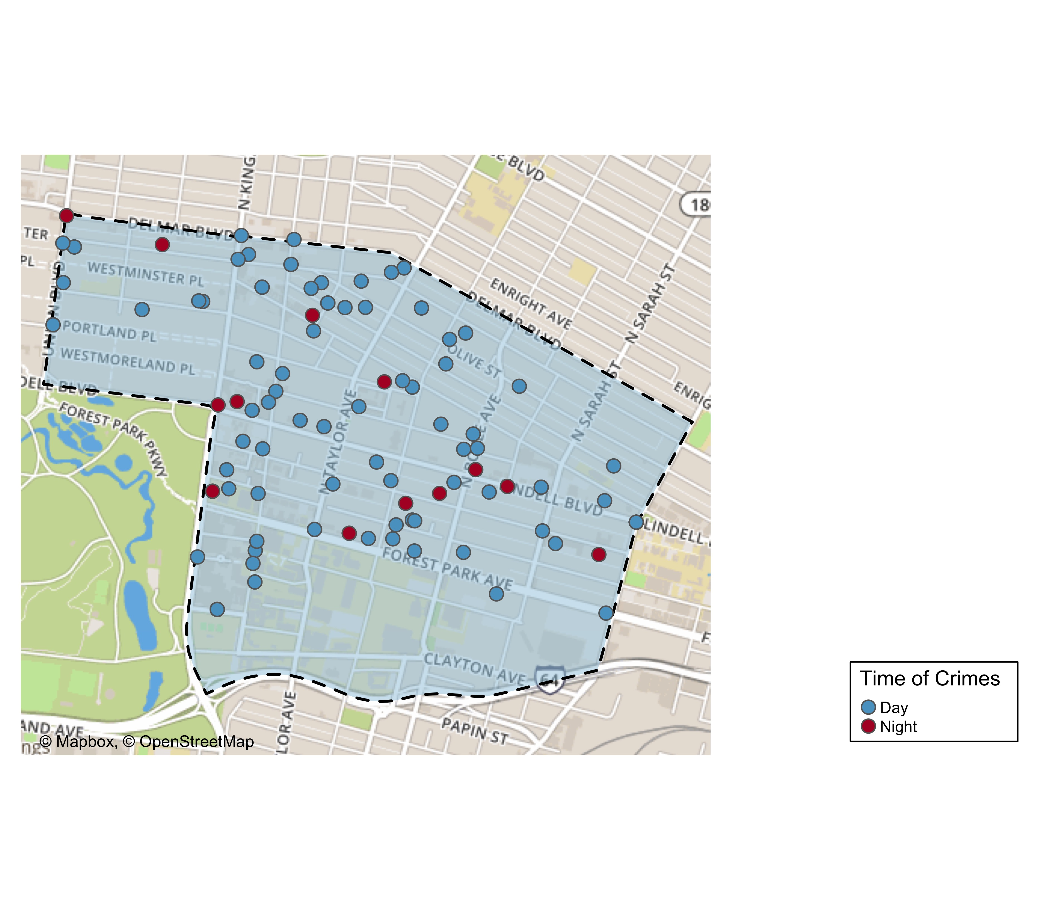
Central West End: Time of Crimes Map

Slide 35
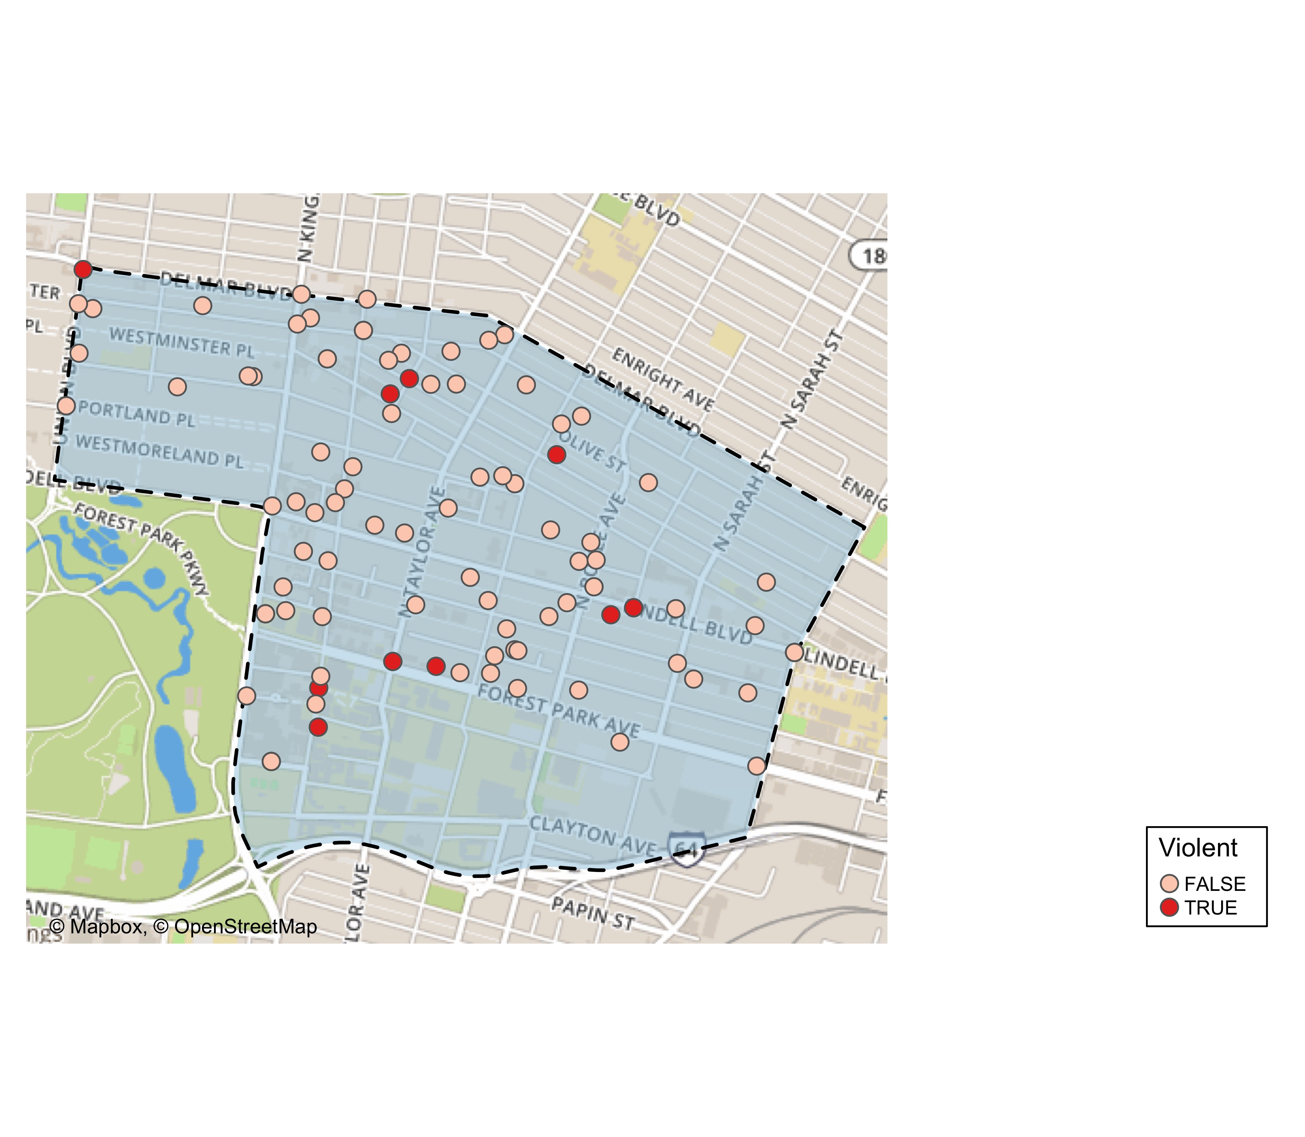
Central West End: Violent Crime Map

Slide 36
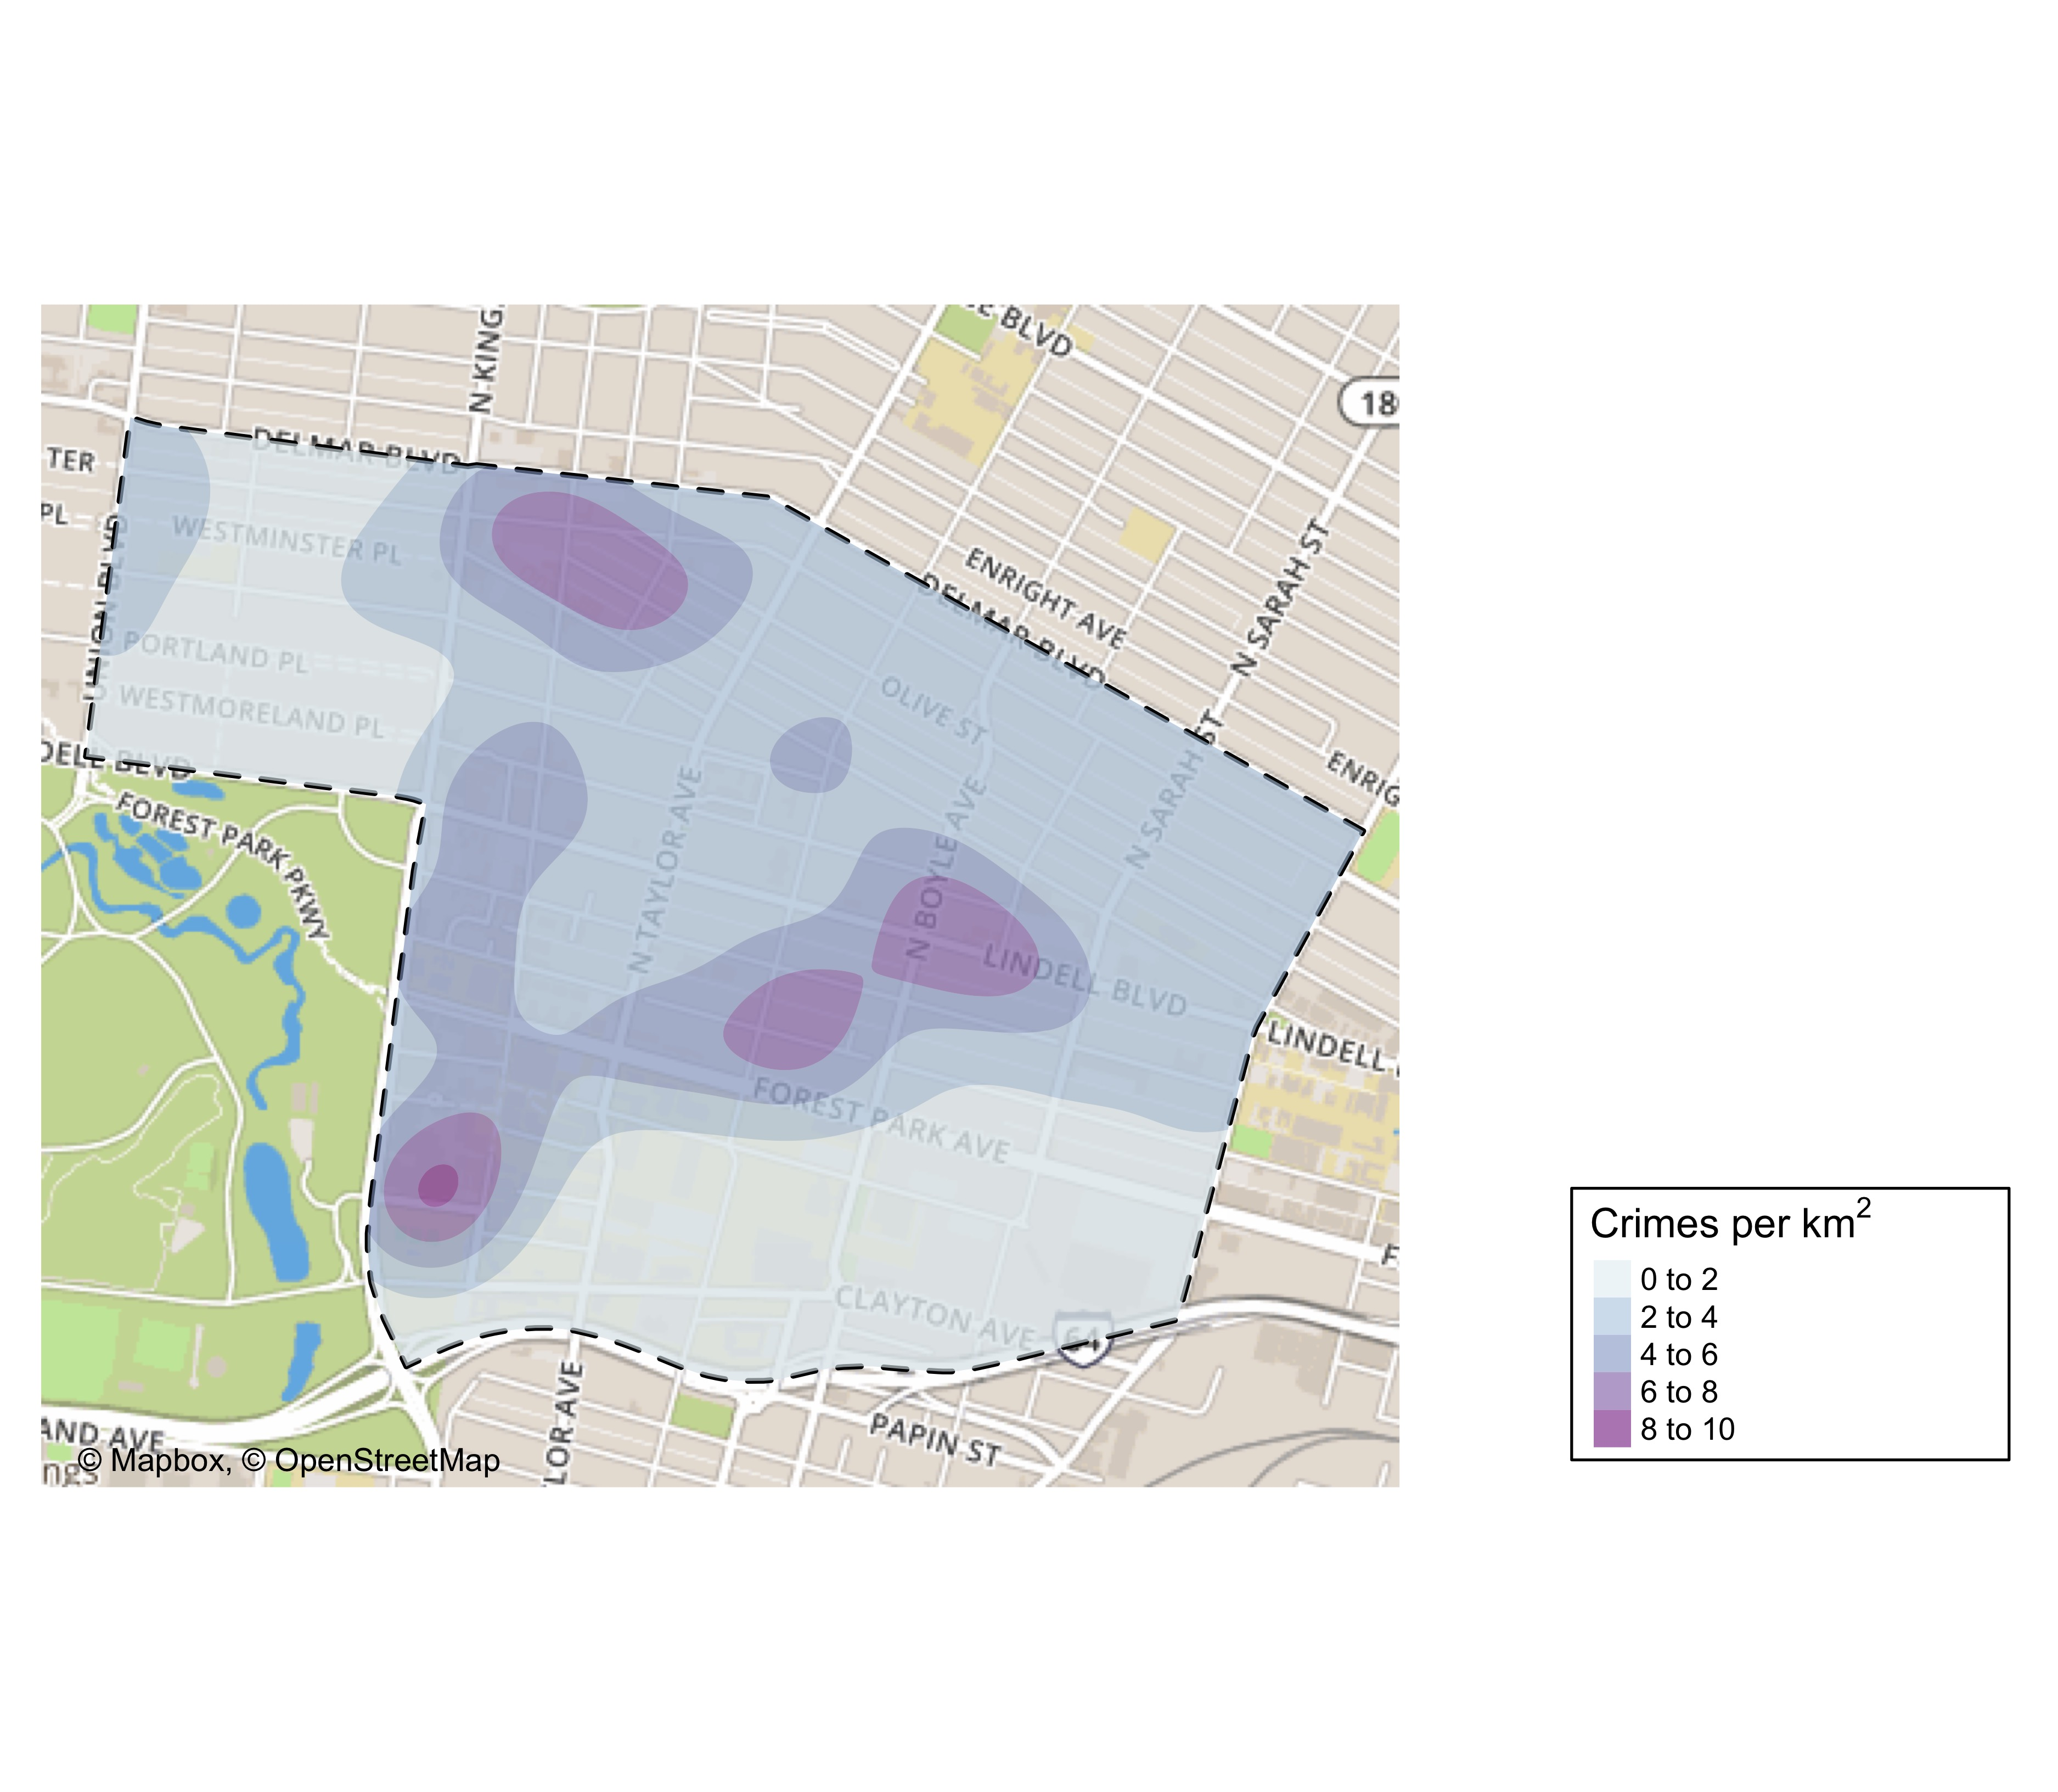
Central West End: Crime Density Map

Slide 37
Central West End: Larceny Breakdown
Day of the Week | Number of Crimes
Sun | 8
Mon | 8
Tue | 8
Wed | 19
Thu | 9
Fri | 18
Sat | 8
Total | 78
Time of Day | Number of Crimes
Day | 70
Night | 8
Total | 78
Type of Larceny | Number of Crimes
All Other | 3
From Building | 11
From Motor Vehicle | 40
Motor Vehicle Parts | 16
Shoplifting | 7
 | 1
Total | 78
Monetary Value | Number of Crimes
$500 - $24,999 | 17
Under $500 | 61
Total | 78

Slide 38
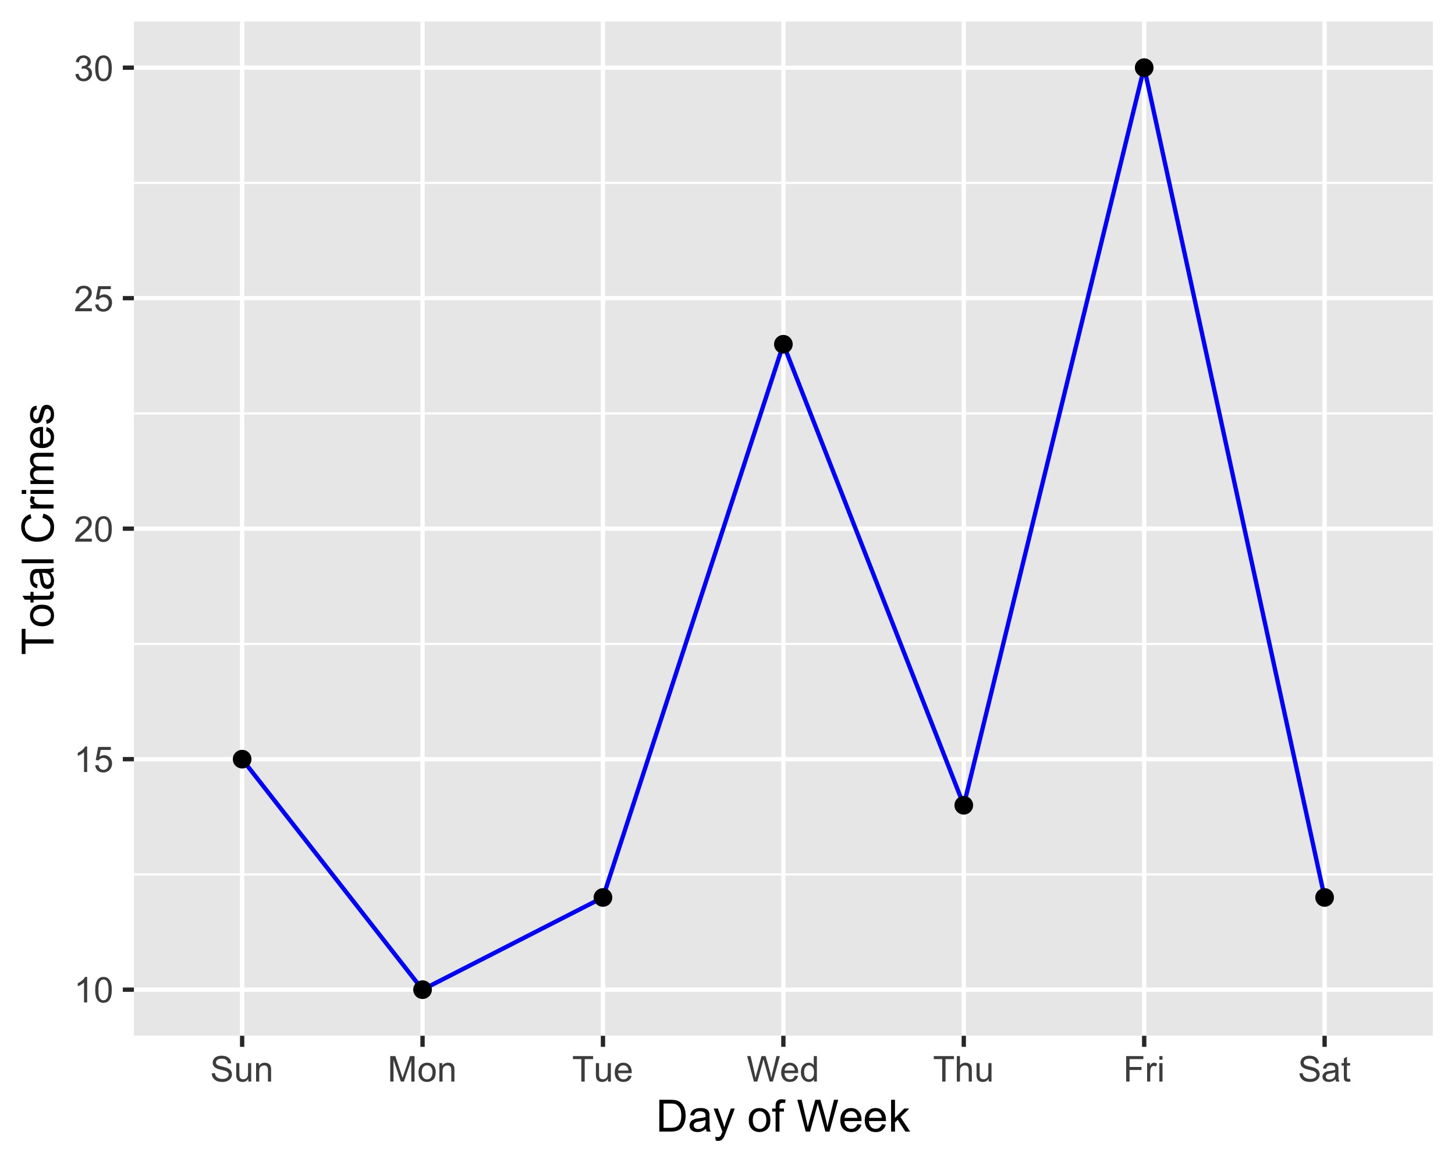
Central West End: Total Crimes by Days of the Week

Slide 39
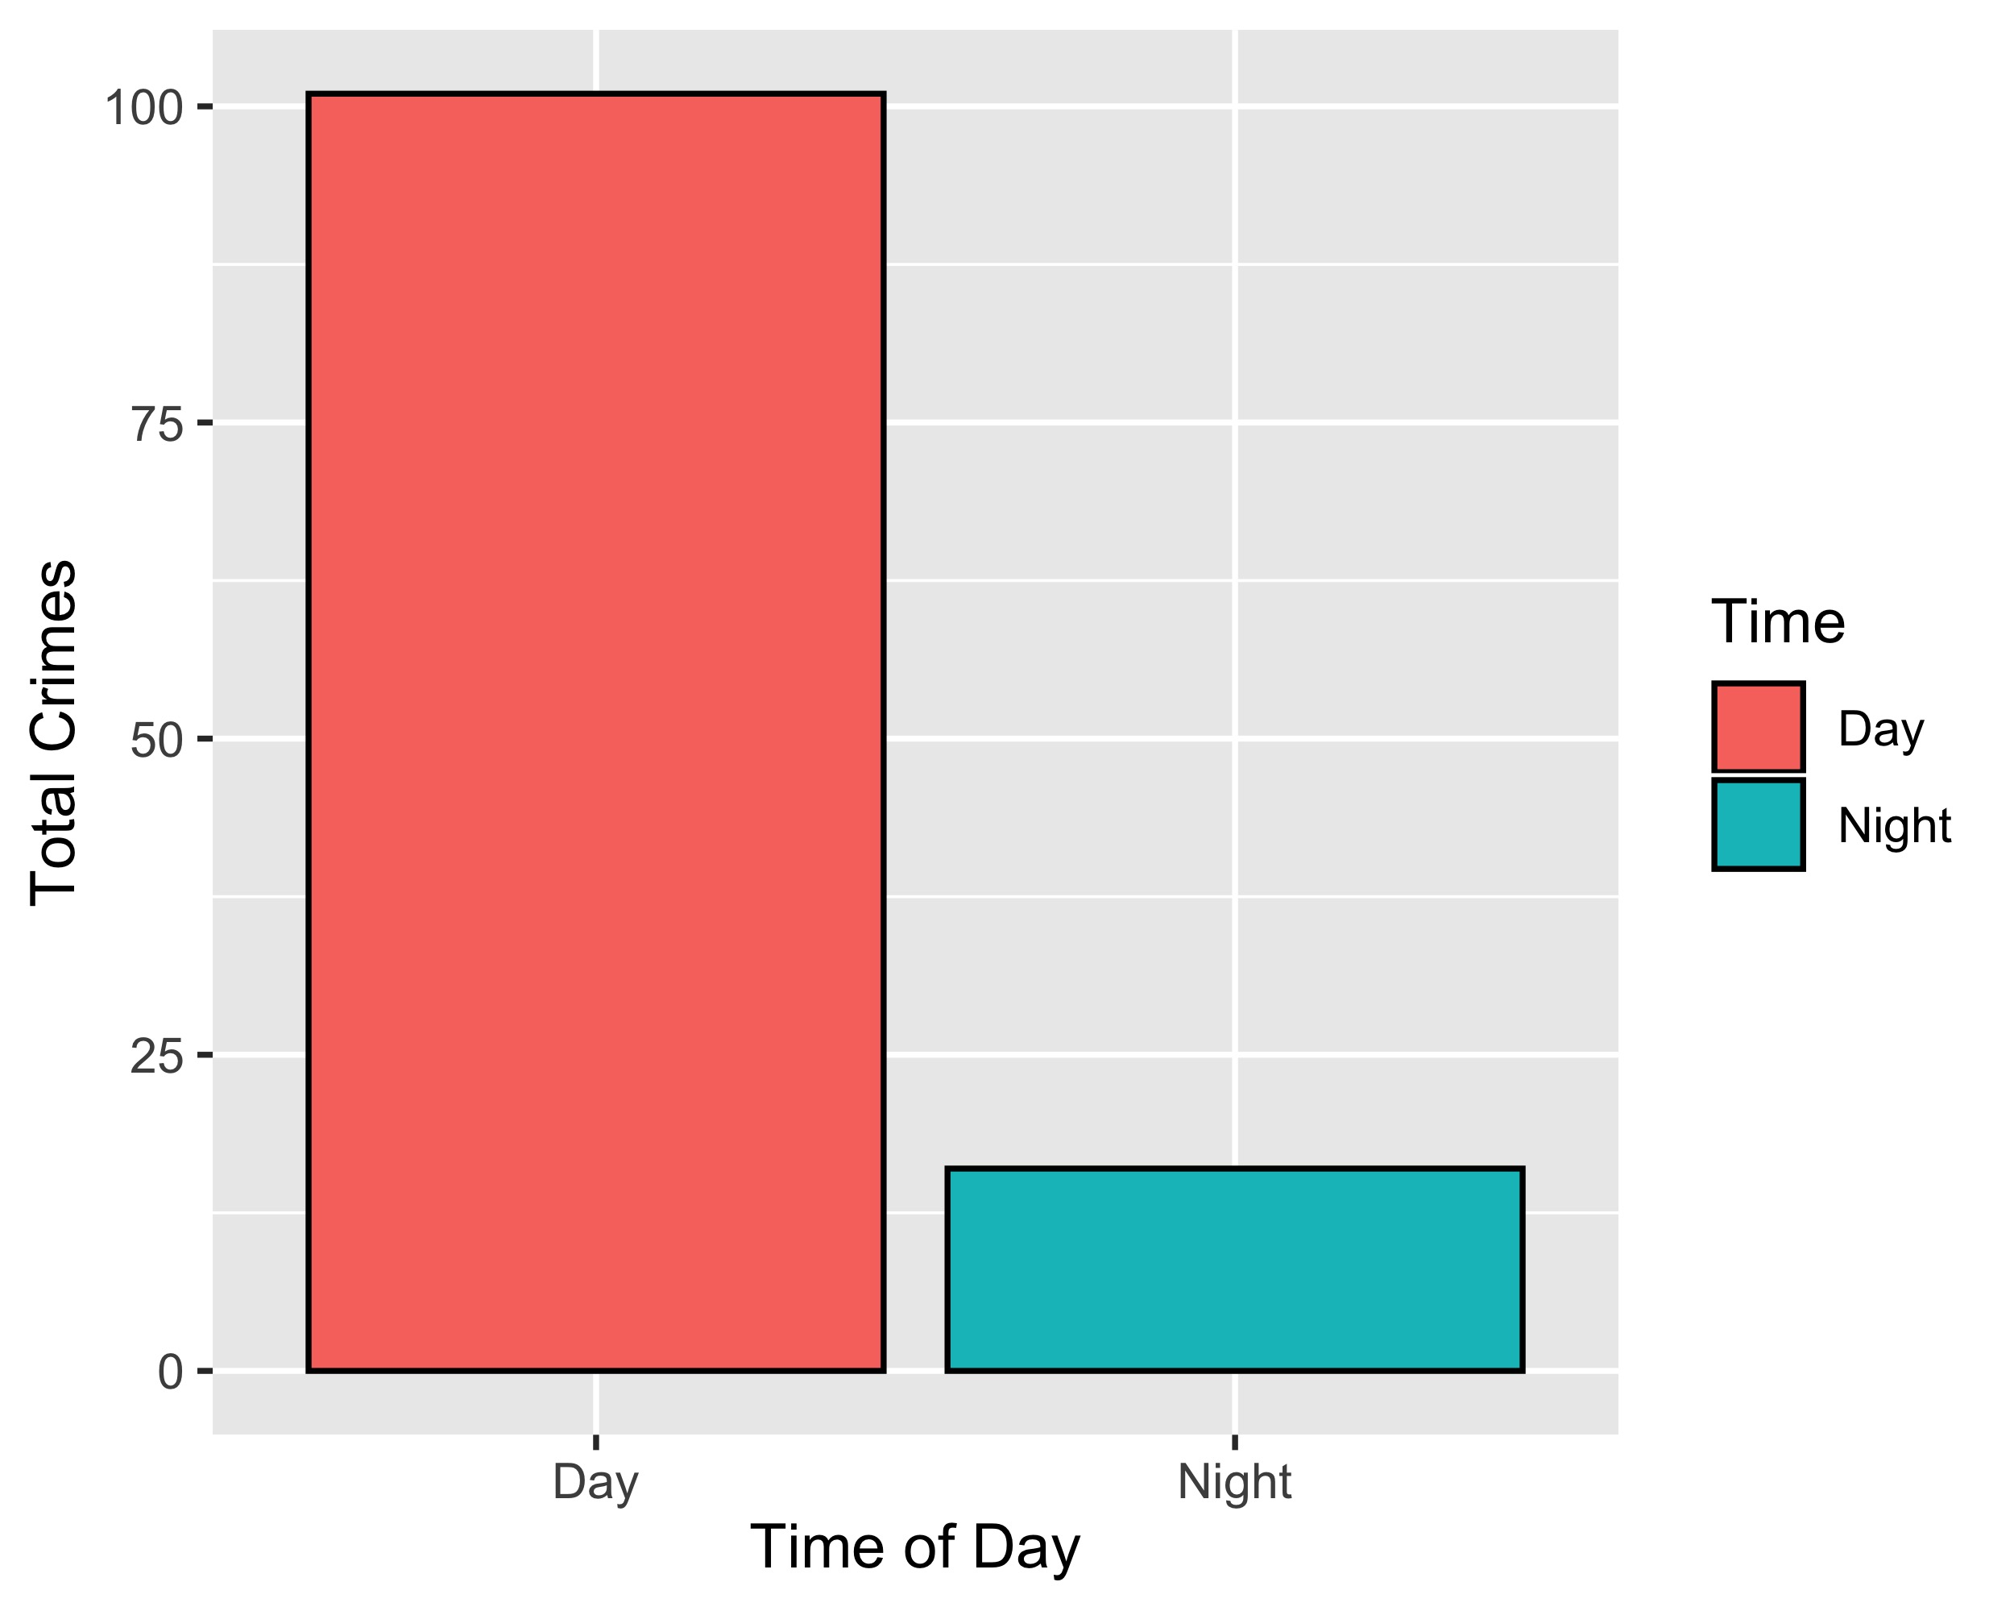
Central West End: Crimes by Time of Day

Slide 40
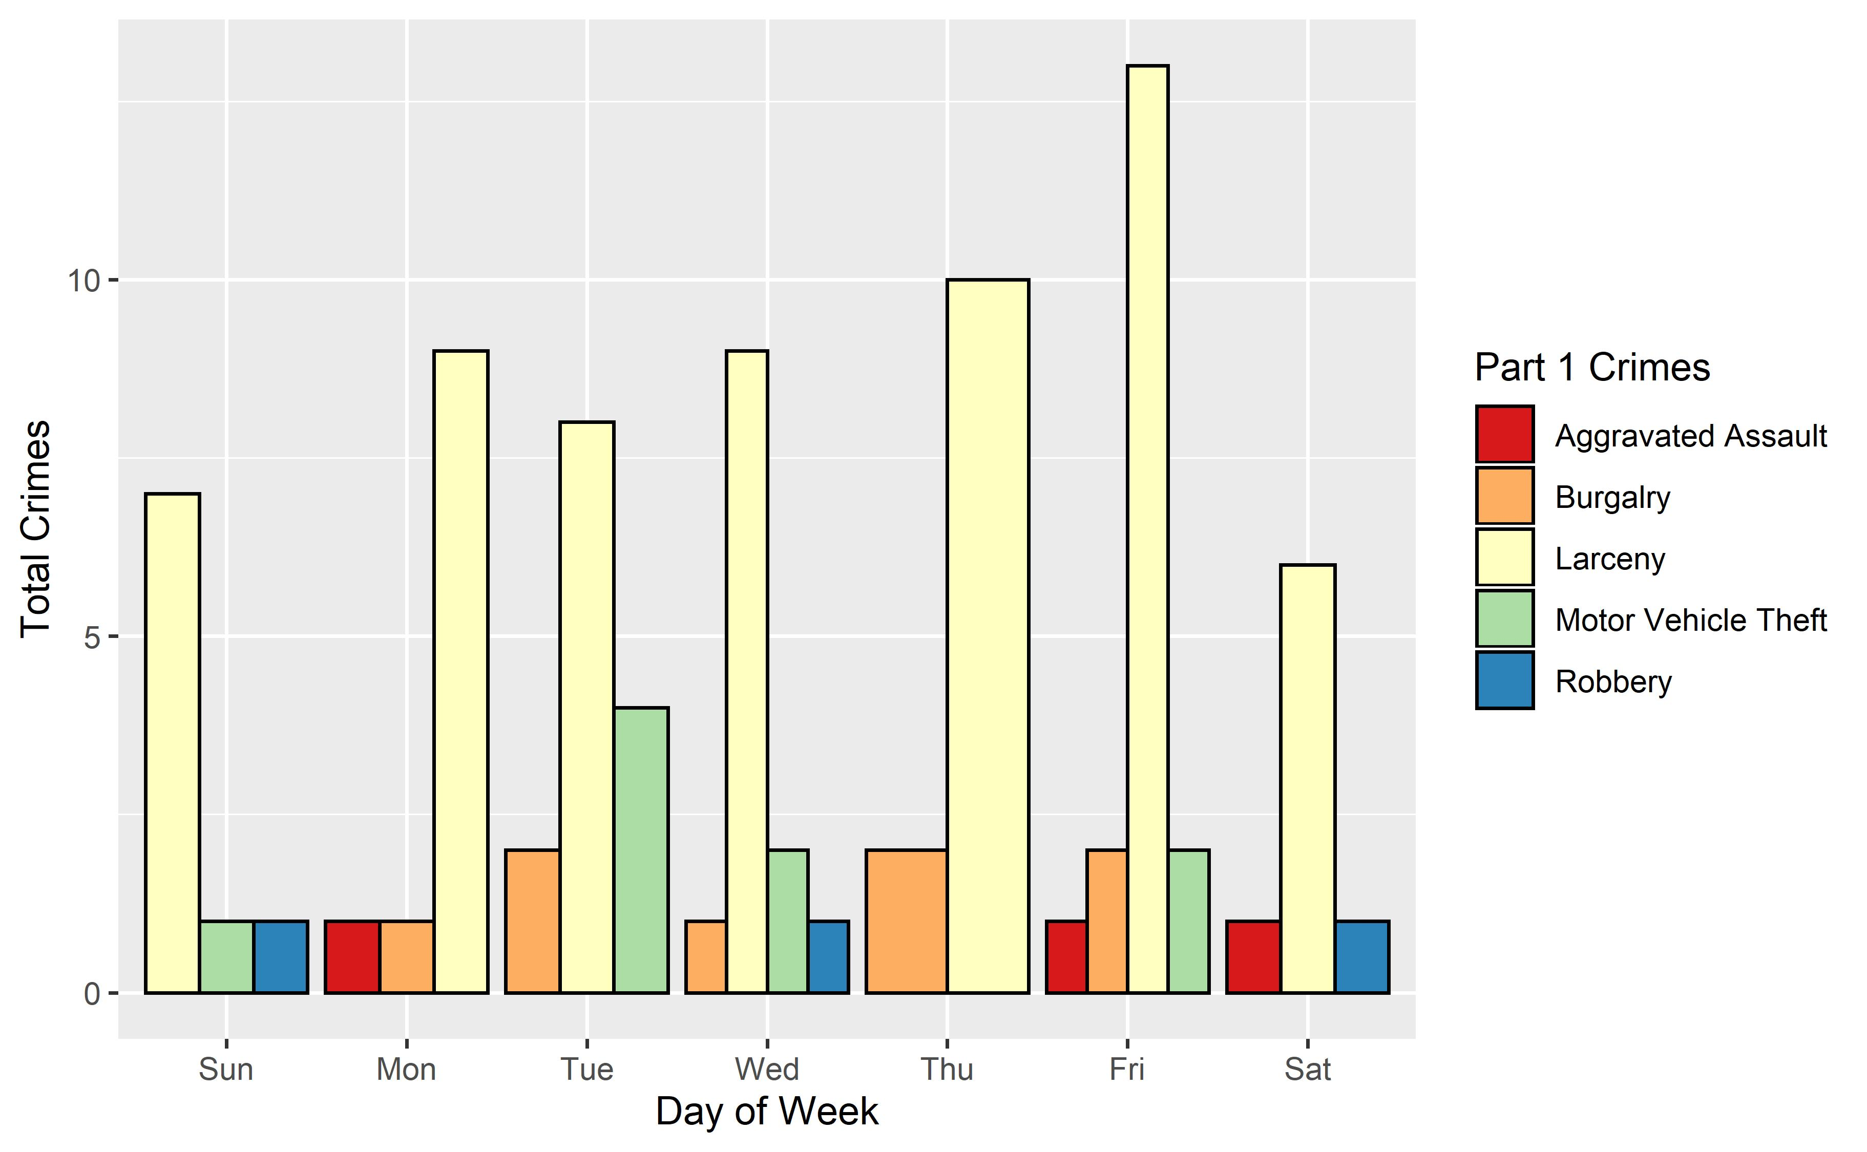
Central West End: Crimes by Day & Category

